Slide 1


VOLUME 1
Correlations
A resource for action and consensus in clinical measurement
1.0

Slide 2
WITH THANKS TO OUR CONTRIBUTORS
Our contributors
The 32 people below shaped Volume 1 through review, discussion and data. Listed alphabetically by first name.
Aaron Yarlas
Ionis Pharmaceuticals
Abi Williams
Adelphi Values
Alexandra Lauer
Boehringer Ingelheim
Aline Frick
TiliaHealth
Amy M Jones
Novo Nordisk
Brandon Foster
Personal capacity
Bryce B. Reeve
Population Health Sciences, Duke University
Catarina Lopes Dias
University of Graz
Dara O'Neill
Patient Centered Solutions, IQVIA
David A. Andrae
BioMarin
Don Bushnell
Thermo Fisher Scientific
Dorothee Oberdhan
University of Sunderland
Elizabeth (Lizzie) Collins
Clarivate
Emmanuel Streel
Altoida, Inc.
Franco Di Cesare
Leoben Research Aurora
Jacquie Mogle
RTI International
Jenya Antonova
Compass Strategy and Research, Inc.
Jessie P Bakker
Candlagan Consulting LLC
Jonathan Comins
Sports Traumatology, Copenhagen University Hospital
Julio César Sánchez-Arévalo
Universidad FUCS
Katerina Stravoravdi
Clinical Research Unit, Papageorgiou General Hospital, School of Medicine, AUTH
Kristine Ogden
Otsuka Pharmaceutical Development & Commercialization, Inc.
Kshawna Askew
Independent
Marta Surlej
PHUSE RBQM Working Group
Meg Fluharty
Acaster Lloyd Consulting
Nace Mikus
TiliaHealth
Oren Meyers
GSK
Prathiba Batley
GSK
Sarah Clifford
Sprout Health Solutions
Sarah M. Donelson
Bristol Myers Squibb
Theresa Coles
Duke University
Tim Pickles
Leeds Beckett University
Volume 1 · Correlations · 1.0
Page 1 of 2

Slide 3

















WITH THANKS TO OUR COLLABORATORS
Corporate Collaborators
The organizations below back Volume 1 with people, review and data.
Acaster Lloyd Consulting
Adelphi Values
Altoida
Boehringer Ingelheim
Candlagan Consulting LLC
Compass Strategy and Research
Duke University
ECNP Clinical Outcomes TWG
GSK
Ionis Pharmaceuticals
Leeds Beckett University
Leoben Research Aurora
Sprout Health Solutions
Thermo Fisher Scientific
TiliaHealth
Universidad FUCS
University of Sunderland
Is your organization missing? If your team contributed data, review or expertise to Volume 1 and is not listed yet, let us know and we'll add your logo to the next printing.
Volume 1 · Correlations · 1.0
Page 2 of 2

Slide 4





PREFACE · WHY, WHAT, WHO & WHERE
Why this resource exists, and who it is for
WHY
WHO
WHERE
WHAT
There are many psychometric methods, implementations of the methods, and interpretations of the results. This wealth of options leads to confusion and inconsistency. This series aims to bring cohesion and consensus to our field
This series is for those who are learning - students and new investigators - who may need pointing in the right direction or grounding. It is also for experienced scientists who need a reference they can point to and to increase consistency between them. It is written by people who do this work daily, for people who will have to defend it.
Broadly, the series should be used in the development of regulatory documentation and health psychometric more broadly. For this volume specifically, it should be used at the points where a correlation is needed for decision making: the analysis plan, the validation report, the submission dossier, and the review of someone else's analysis.
Volume 1 covers correlations. Later volumes take the same shape for the other methods or properties.
Volume 1 · Correlations · 1.0

Slide 5

APPENDIX · REFERENCE
Glossary
Between-subject correlation — Association between individuals’ average levels of two variables. Reflects stable differences between people.
Person-mean centering — Subtracting each person’s mean from their observations to separate within- from between-subject variability.
Within-subject correlation — Association between deviations from each person’s own mean across occasions. Reflects co-variation for an individual over time.
Intraclass correlation (ICC) — Proportion of total variance from stable between-subject differences; here, the degree of clustering within people.
Total correlation — A standard correlation across all observations, ignoring nesting. Conflates both between subjects and within subject correlations; not interpretable alone.
Ecological fallacy — Inferring individual-level dynamics from group-level associations (Robinson, 1950; Curran & Bauer, 2011).
Nesting — A structure in which observations belong to a higher unit (timepoints within a person). Violates the independence assumption.
Simpson’s Paradox —Statistical phenomenon in which a trend observed within a patient, reverses or disappears when between-patients trend is analyzed.
Volume 1 · Correlations · 1.0

Slide 6
APPENDIX · REFERENCE
Glossary
Dependence — Two observations are dependent when knowing one changes what you'd expect for the other. Two visits from the same patient, unlike two different patients.
Corrected (item-total correlation) — « Corrected » means the item is excluded from the total score it's compared against, so it isn't partly correlated with itself.
Continuous variable — A variable that can take any infinite number of real values within a range.
Clinician Global Impression of Severity (CGIS) — A single item questionnaire asking the clinician to rate the severity of a patient's condition, usually at the time of assessment.
Clinician Global Impression of Change (CGIC) — A single item questionnaire asking the clinician to rate the improvement or worsening in a patient's condition since the start of a study.
Ordinal variable — A variable with categories that have a logical order but the exact distance between the categories is unknown.
Patient Global Impression of Severity (PGIS) — A single item questionnaire asking the patient about their condition, usually referenced over the last week.
Patient Global Impression of Change (PGIC) — A single item questionnaire asking the patient to rate the improvement or worsening in their condition since the start of a study.
Binary variable — A variable with two categories only.
Lord’s Paradox — The longitudinal analogue of Simpson's Paradox: adjusting for baseline can flip the direction of a change effect.
Volume 1 · Correlations · 1.0

Slide 7

TOPIC 1
What is a correlation coefficient?
The coefficient, its assumptions, and where it shows up in clinical outcome assessment
Volume 1 · Correlations · 1.0

Slide 8
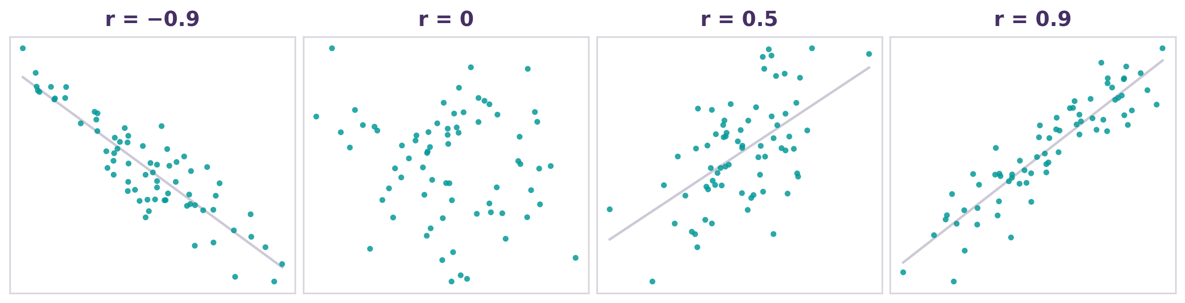

TOPIC 1 · THE COEFFICIENT
What is a correlation coefficient?
A correlation coefficient is a single number that captures how strongly two variables move together, and in which direction.
r = cov(X, Y) / (s_{X} · s _{Y})
Covariance of X and Y divided by the product of the standard deviations of X and Y
Illustrative scatter at four values of r.
Sign gives the direction: positive means both variables tend to increase or decrease together; negative means one tends to increase as the other decreases. Sign doesn’t give the strength, a correlation of -0.9 is as strong as a correlation of 0.9
Magnitude gives the strength: 0 is no linear association, 1 is a perfect one. Within this range, the magnitudes are classified as negligible, small, moderate, and strong (threshold benchmarks).
Standardized and bounded: correlation coefficient ranges from −1 and +1, so they are comparable across different situations (measures and item pairs across one measure).
Written r, not “correlation”: r is one specific coefficient (Pearson’s, used for continuous data). Other types of correlation coefficient suit other types of data (see Topic 3).
KEY INSIGHT
A correlation is a standardized effect size: its magnitude tells you how strong the association is.
Judge correlation coefficient by size, not by whether it statistically differs from zero.
Volume 1 · Correlations · 1.0

Slide 9


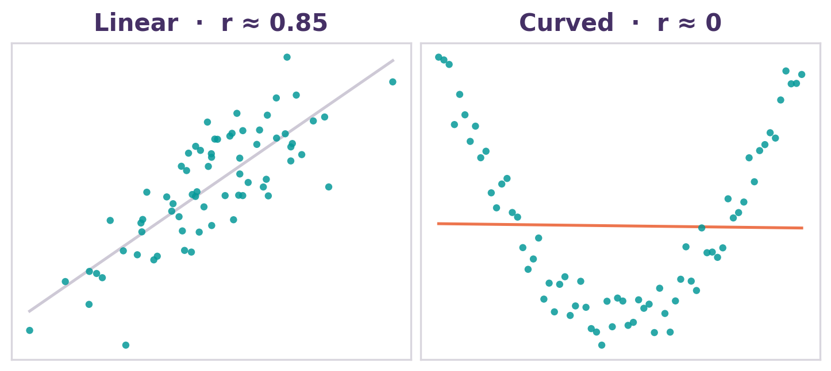
TOPIC 1 · ASSUMPTIONS
Linearity and the assumptions behind r
Pearson’s coefficient (r) measures the strength of the linear relationship only, so always plot the data before trusting it.
ASSUMPTIONS FOR PEARSON r
Linear relationship
No dominant outliers
Unrestricted (adequate) range
Continuous, interval-level data
Even spread of points (homoscedasticity)
Roughly bivariate-normal shape (for p-values and confidence intervals(CIs))
Same underlying relationship, very different r.
Next: what each assumption looks like.
Ordinal, skewed, or monotonic-but-non-linear data → use Spearman’s ρ (see Topic 3 for more details on Spearman and other correlation coefficients existing).
Volume 1 · Correlations · 1.0

Slide 10

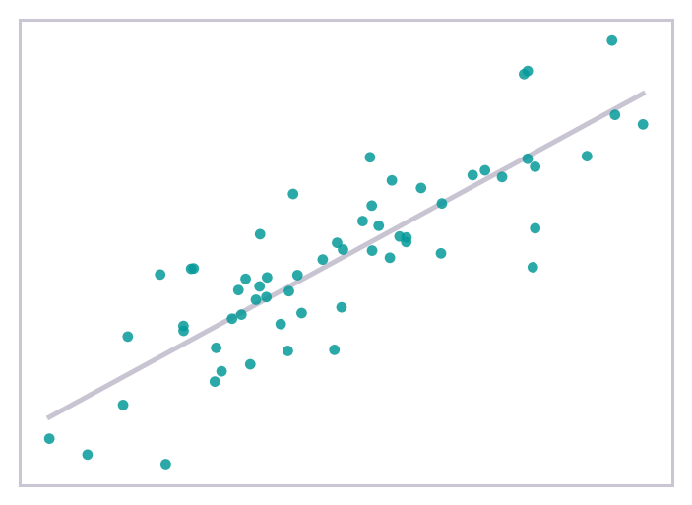
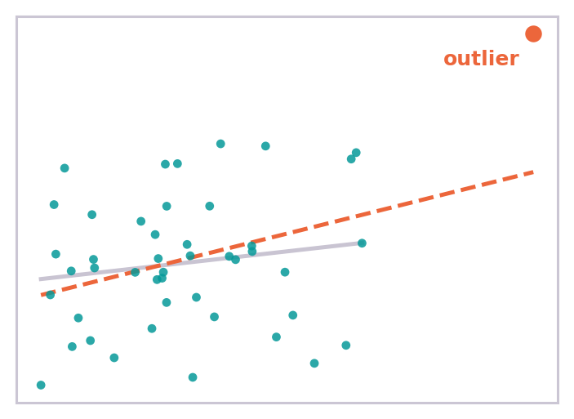
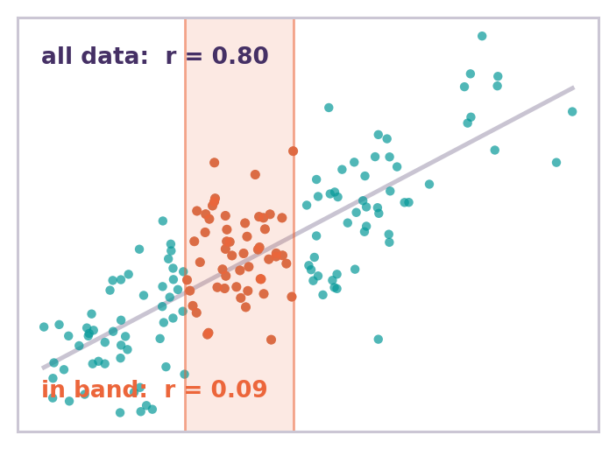
TOPIC 1 · ASSUMPTIONS
What the assumptions look like (1 of 2)
Linear relationship
No dominant outliers
Unrestricted range
The scatterplot formed by the data follow a straight line. The Pearson coefficient (r) can capture this relationship
One extreme point can create (or hide) a correlation. Check its influence before trusting r.
Narrowing the range shrinks r. Here it falls from 0.80 across all data to near zero inside the band (restricted range).
Volume 1 · Correlations · 1.0

Slide 11
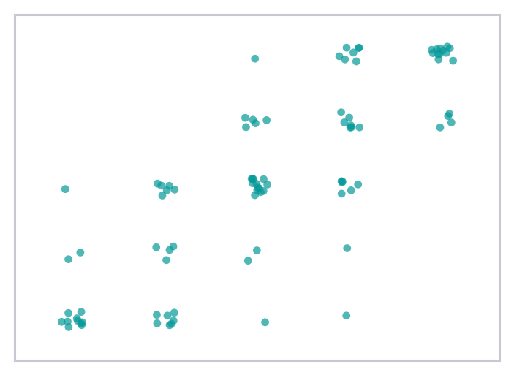
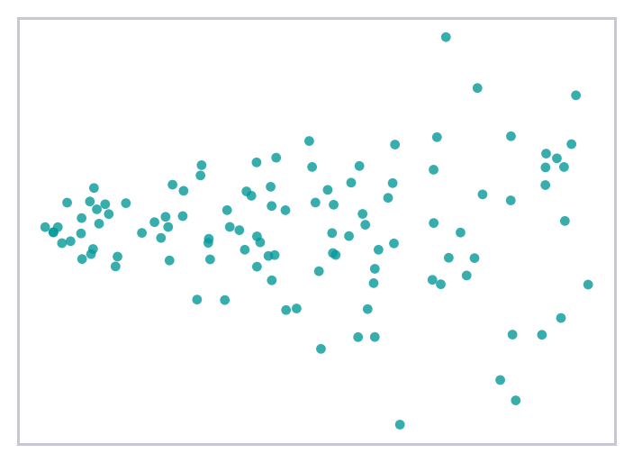
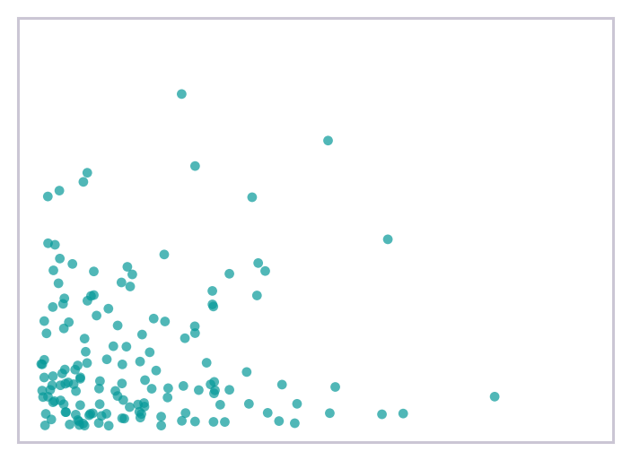
TOPIC 1 · ASSUMPTIONS
What the assumptions look like (2 of 2)
Continuous data
Even spread
Roughly normal shape
Few discrete levels (e.g., a 5-point item) suit Spearman or polychoric correlations (Topic 3).
Spread should stay roughly constant. A fan shape signals heteroscedasticity and weakens inference.
Skew and heavy tails distort p-values and confidence intervals, though not the estimate itself.
Volume 1 · Correlations · 1.0

Slide 12


TOPIC 1 · INTERPRETATION
Correlation is not causation
A correlation shows that two measures vary together. It does not show that one causes the other.
Confounder (Z)
Z
Correlations could be caused by:
Confounding: a third variable drives both.
Reverse causation: the effect may run the other way.
Chance or selection: coincidence, or how the sample was drawn.
X
observed r
Y
IN PRACTICE
In evaluation of Clinical Outcome Assessments (COAs) data, a strong PRO–anchor (patient-reported outcome-anchor) correlation supports a shared construct (validity evidence). It does not prove that changing one changes the other.
PRO (X)
Anchor (Y)
Volume 1 · Correlations · 1.0

Slide 13
TOPIC 1 · EXAMPLES
Correlation is not causation (2 of 2)
Confounding
Reverse causation
Chance or selection
Situation: A strong correlation between poor scores on a psychometric memory test (such as the Mini-Mental State Evaluation, MMSE) and high scores on a gait disorder rating scale in elderly patients is observed.
Wrong Conclusion: « Memory loss causes disorientation, which leads to a loss of balance. »
Correct conclusion: Confounding, underlying pathology causes both.
Situation: A strong correlation between a high score on a health anxiety inventory and an irritable bowel syndrome severity is observed.
Wrong Conclusion: « These patients' anxiety is psychosomatic and causes their intestinal pain. »
Correct conclusion: The causality is reversed.
Situation: A strong correlation is found between a severity score of schizophrenia and the likelihood of developing cardiovascular disease.
The study is conducted in a hospital emergency department.
Wrong Conclusion: « Schizophrenia causes cardiovascular disease. »
Correct conclusion: Looking only at hospitalized patients, an artificial correlation is created.
Volume 1 · Correlations · 1.0

Slide 14

TOPIC 1 · WHERE IT SHOWS UP
Correlation underpins many elements of COA
Convergent
& Divergent
Factor /
Structure
Criterion /
Anchor (cross-sectional & longitudinal)
Inter-Item
Correlation
Reliability
Local
Dependence
Volume 1 · Correlations · 1.0

Slide 15
TOPIC 1 · WHERE IT SHOWS UP
How correlation supports evaluation of psychometric properties of a COA instrument
(1 of 2)
Inter-item correlations
Factor analyses and item structure
Convergent & divergent validity
Correlations among the items in a scale show whether they belong together. Moderate, positive values suggest items tap into the same construct; a very high correlation coefficient may signal redundancy, and a near-zero correlation coefficient may indicate that the items do not contribute to the same scale (i.e., construct). Inter-item relies on reliability.
The correlation matrix is the raw material for factor analysis (can also be a covariance matrix). Its pattern reveals the latent structure: how many factors are present in the data, and which items are associated with each factor (EFA, exploratory factor analysis and CFA, confirmatory factor analysis).
A complete understanding of the latent structure requires other analyses (latent variables).
Validity evidence rests on the size of correlations with other measures: strong links with the same construct (convergent) and weaker links with unrelated ones (divergent) (Campbell & Fiske, 1959). Other measures used must be validated themselves.
Volume 1 · Correlations · 1.0

Slide 16



TOPIC 1 · WHERE IT SHOWS UP
How correlation supports psychometric properties of a COA instrument
(2 of 2)
Criterion correlation / Anchor
Test–retest reliability
Local dependence
Correlating a COA with an external anchor or criterion (such as a global rating) supports interpretation and underpins responsiveness and meaningful-change work. The anchor must itself be valid, reliable and at least moderately related to the concept of interest.
The correlation or intraclass correlation (ICC) between assessment on two occasions in stable patients is an index of reproducibility. A high value means the score stays consistent when the underlying state has not changed.
In factor analyses, once the latent trait has been identified, item residuals should be roughly uncorrelated. Leftover residual correlations signal local dependence, which can inflate reliability estimates and distort scoring (Chen & Thissen, 1997).
Volume 1 · Correlations · 1.0

Slide 17

TOPIC 1 · WRAP-UP
Key takeaways
1
A correlation is a standardized effect size for association: direction from the sign, strength from the magnitude, range of −1 to +1 scale.
1
2
Pearson’s r captures linear association only. Plot the data first and choose the right coefficient (e.g. Spearman for ordinal data).
3
Association is not causation: confounding, reverse causation, and chance can each produce a correlation.
4
Across COA work, correlations underpin reliability, structure, and validity evidence; the research question determines what you compute.
Volume 1 · Correlations · 1.0

Slide 18
APPENDIX · REFERENCES
References and further reading
Slide-specific references
Robinson, W. S. (1950). Ecological correlations and the behavior of individuals. Am Sociol Rev, 15, 351-357;
Curran, P. J., & Bauer, D. J. (2011). The disaggregation of within-person and between-person effects in longitudinal models of change. Annu Rev Psychol, 62, 583-619.
Slide 13 Campbell, D. T., & Fiske, D. W. (1959). Convergent and discriminant validation by the multitrait–multimethod matrix. Psychological Bulletin, 56(2), 81-105.
Slide 14 Chen, W.-H., & Thissen, D. (1997). Local dependence indexes for item pairs using item response theory. J Educ Behav Stat, 22(3), 265-289.
Foundations Cohen, J., Cohen, P., West, S. G., & Aiken, L. S. (2003). Applied Multiple Regression / Correlation Analysis for the Behavioral Sciences (3rd ed.). Erlbaum; Nunnally, J. C., & Bernstein, I. H. (1994). Psychometric Theory (3rd ed.). McGraw-Hill;
Mukaka, M. M. (2012). A guide to appropriate use of correlation coefficient in medical research. Malawi Med J, 24(3), 69-71;
FDA (2009). PRO Measures: Use in Medical Product Development to Support Labeling Claims.
Volume-wide further reading:
Volume 1 · Correlations · 1.0

Slide 19
TOPIC 2
Methods for correlation-based questions
Choosing the right correlation for the question you are asking
Volume 1 · Correlations · 1.0

Slide 20


TOPIC 2 · OVERVIEW
Three methods, three questions
The data structure and the research question determine the type of correlation to compute.
Cross-sectional
Analysis of correlation at one timepoint
Change / longitudinal
Analysis of change over time
Within & between
A single timepoint is available for all patients.
Multiple timepoints are available for all patients.
Repeated measures, nested in patients.
How much association is within vs between patients?
Do patients who differ on X also differ on Y?
Do patients who change on X also change on Y?
Application: Construct validity · usually strong correlation r for related measures (X and Y)
Application: Responsiveness · usually weaker r because of compound error
Separates the two (Within Between)
Cross-sectional and longitudinal methods contribute to the validation argument: cross-sectional correlations show the instrument captures the concept; change correlations support that it can detect change over time and within patients.
Volume 1 · Correlations · 1.0

Slide 21
CROSS-SECTIONAL CORRELATION · THEORY
Correlating two measures at one timepoint
A cross-sectional correlation asks whether two measures increase and decrease together, among patients at a single timepoint. It reflects differences between patients at a given timepoint, not changes within them over time.
KEY INSIGHT
A cross-sectional correlation shows the instrument properties at one moment. It does not show that it detects change over time.
The standard for construct validity: convergent (high with related measures) and divergent (low with unrelated).
It usually gives stronger correlations than change-based methods.
Its assumptions are those of any correlation (Topic 1): linearity, a coefficient matched to the data, adequate range.
Supports: cross-sectional construct validity (a between-patient property).
Volume 1 · Correlations · 1.0

Slide 22

CROSS-SECTIONAL CORRELATION · OUTPUTS
Interpreting a correlation matrix
 | New PROM | Related A | Related B | Unrelated
New PROM | 1.00 | 0.72 95% CI [0.65, 0.78] | 0.65 95% CI [0.56, 0.72] | 0.18 95% CI [0.04, 0.31]
Related A | 0.72 95% CI [0.65, 0.78] | 1.00 | 0.58 95% CI [0.48, 0.67] | 0.22 95% CI [0.08, 0.35]
Related B | 0.65 95% CI [0.56, 0.72] | 0.58 95% CI [0.48, 0.67] | 1.00 | 0.20 95% CI [0.06, 0.33]
Unrelated | 0.18 95% CI [0.04, 0.31] | 0.22 95% CI [0.08, 0.35] | 0.20 95% CI [0.06, 0.33] | 1.00
How to interpret it
Set expectations first: related measures should have high correlation coefficients; unrelated measures should have low correlation coefficients.
Report each correlation coefficient with a 95% confidence interval, and judge the size, not the statistical significance (benchmarks: Topic 4).
The entire matrix shows the inference validity at a glance.
REUSABLE CONCLUSION
As hypothesized, [New PROM] correlated strongly with [related measure A] (r = .72, 95% CI 0.65, 0.78) and had a weak relationship with [unrelated measure] (r = .18, 95% CI 0.04, 0.31), supporting convergent and divergent validity.
A new PRO converges with related measures and diverges from an unrelated one.
Volume 1 · Correlations · 1.0

Slide 23

CROSS-SECTIONAL CORRELATION · EXAMPLE
A worked example
New PROM vs an established related measure: r = 0.72 (convergent, as expected).
New PROM vs an unrelated measure: r = 0.18 (divergent, as expected).
Each coefficient is reported with a 95% confidence interval and judged by its size.
R · RUNS ON THE EXAMPLE DATASET
# CDISC BDS is long: pivot to wide first
wide <- adcorr %>%
filter(AVISIT == "Baseline") %>%
pivot_wider(id_cols = USUBJID,
names_from = PARAMCD,
values_from = AVAL)
ct <- cor.test(wide$TARGTOT, wide$RELATEDA)
ct$estimate # r = 0.73
ct$conf.int # 95% CI 0.66 to 0.79
IN PRACTICE
Each coefficient is checked against a pre-specified hypothesis. Together they build the cross-sectional construct-validity argument.
Volume 1 · Correlations · 1.0

Slide 24
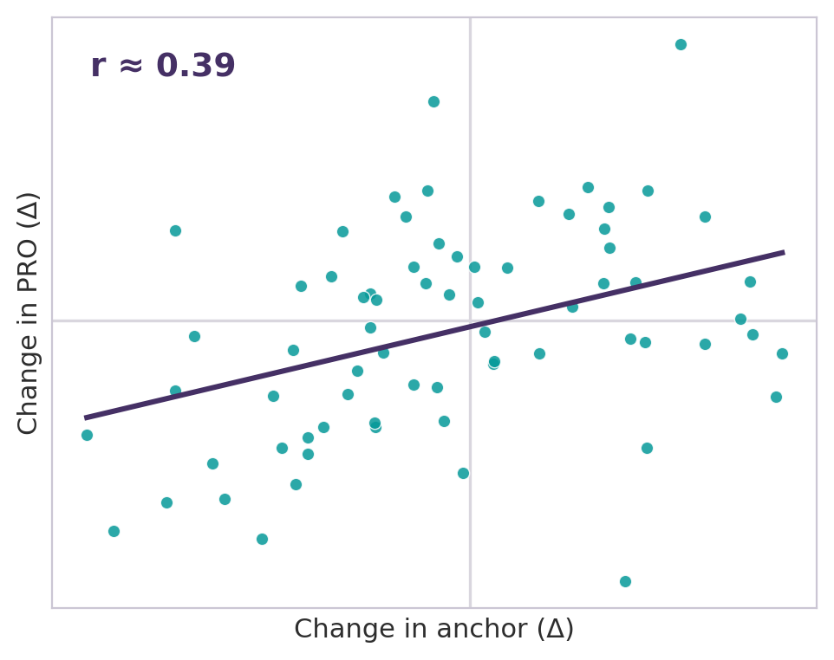
CHANGE-SCORE CORRELATION · THEORY
Correlating change over time
A change-score correlation assesses whether patients who change on one measure also change on another. It is computed on change scores and reflects responsiveness, the longitudinal aspect of validity.
ΔPRO = PRO₁ − PRO₀ ΔAnchor = Anchor₁ − Anchor₀ then r(ΔPRO, ΔAnchor)
Change scores result from subtracting two measurements, so their errors compound (a change correlation is attenuated by the reliability of the change score itself; reliability): this is why change correlations are typically lower than cross-sectional ones (Cronbach & Furby, 1970).
Use Pearson or Spearman correlation coefficient, matched to the distribution of the change scores (Topic 3).
An anchor is an external measure used to interpret change (e.g. PGIS, CGIS, anchors); its quality drives the result. If the chosen anchor is not robust (its use has not been supported by previous evidence) or is used incorrectly, the resulting outcome may be difficult to interpret. Validity of anchors can be established qualitatively as there is no internal structure to be assessed. However larger packages of qualitative and quantitative checks can support anchor validity.
Change in a PRO against change in an anchor, one point per patient.
Thresholds for an adequate anchor correlation: Hays (2005): 0.37; Guyatt (2000) 0.5; acceptable: 0.3
Volume 1 · Correlations · 1.0

Slide 25

CHANGE-SCORE CORRELATION · WHEN TO USE
When it works and when it doesn’t
USE WHEN
AVOID WHEN
Changes in two measures may move together over time.
Data from only one timepoint is available.
Both the COA and the anchor are measured at baseline and follow-up (not anchors of change collected at follow up only).
Most patients stay stable, leaving little true change to correlate.
The anchor is theoretically related, interpretable, and pre-specified.
The anchor is weak (no previously validation evidence), poorly selected, not matched to the same or a related concept, or hard to interpret.
There is enough variability in change among patients.
Change is dominated by error, floor/ceiling effects, or timepoint mismatch (different timepoints used).
Volume 1 · Correlations · 1.0

Slide 26
CHANGE-SCORE CORRELATION · INTERPRETATION
Interpret it as hypothesis-driven evidence
Interpret a change correlation as pre-specified evidence of expected change, not as stand-alone proof of responsiveness or validity. It supports responsiveness but can’t confirm it alone: the value also depends on the anchor, and how much true change occurred.
WATCH OUT
If the strength of the correlation is not aligned with expectations, it does not necessarily mean there is an issue with the COA. It may reflect a weak anchor, little true change, timing mismatch, a restricted range, or measurement error in the change scores.
Consider the scoring direction: improvement can give a positive or negative correlation depending on coding or scoring direction (scoring direction).
Do not treat a weak correlation as automatic proof of non-responsiveness.
Judge against the pre-specified hypothesis and context of use, not statistical significance.
Further pitfalls (measurement error, floor/ceiling, regression to the mean) are covered in Topic 5.
Volume 1 · Correlations · 1.0

Slide 27
CHANGE-SCORE CORRELATION · EXAMPLE
An example
Objective: Compare the correlation score coefficient against the planned threshold and report with a 95% CI.
Result obtained: Change in a PRO vs change on a global rating (CGIS): r = 0.45 (moderate).
Conclusion: This result is consistent with the pre-specified responsiveness hypothesis.
R · RUNS ON THE EXAMPLE DATASET
# BASE and CHG are pre-computed in BDS
d <- adcorr %>%
filter(AVISIT == "Week 12") %>%
pivot_wider(id_cols = USUBJID,
names_from = PARAMCD,
values_from = c(AVAL, CHG))
# change in the PRO against a change anchor
cor.test(d$CHG_TARGTOT, d$AVAL_PGIC) # 0.40
REUSABLE CONCLUSION
Change in [PRO] correlated moderately with change in [anchor] (r = 0.45, 95% CI …), consistent with the pre-specified responsiveness hypothesis.
Volume 1 · Correlations · 1.0

Slide 28
WITHIN & BETWEEN SUBJECTS · THEORY
When data are nested, a correlation isn’t one number
When the same people are measured repeatedly, their observations are not independent. A single correlation then blends two different associations: differences between people, and changes within a person over time.
NESTING: VISITS WITHIN PATIENTS
KEY INSIGHT
A correlation from nested data is an answer to an unspecified question, until you say which level it describes.
One correlation, two levels: always specify if you are measuring differences between individuals or variation over time.
Patient → four monthly visits
Failing to account for the hierarchical nature of the data does not just lose efficiency: it can answer the wrong clinical question.
IN PRACTICE
60 patients × 4 visits = 240 rows, but only 60 independent units.
Volume 1 · Correlations · 1.0

Slide 29
WITHIN & BETWEEN SUBJECTS · THE FOUNDATION
Nested data splits variance into two parts
Repeated observations from one person share variance that comes from stable individual traits. The ICC is the share of total variance that lies between people; the rest lies within people, throughout time points.
Example: ICC = 0.70
70%
30%
High ICC: most information is between people, so a simple total correlation is dominated by the between-subject association.
Low ICC: within-person variation is large, so the total correlation can hide a meaningful within-subject signal.
Very high ICC (0.8–0.9 or more): small within-person variation means that within-subject correlation rests on low signal.
between people
within people
IN PRACTICE
Interpret the ICC as a diagnostic step, before proceeding with the analysis: it tells you how much of any correlation will come from each level, and so which method and which level matter (Curran & Bauer, 2011).
This volume presents the ICC generically. In practice, several ICC variants exist (ICC(2,1), ICC(3,1), Shrout & Fleiss' 1979), which use different variance components and can give different values for the same data.
Because the variance from nested data splits between and within, so does any correlation computed from the data.
Volume 1 · Correlations · 1.0

Slide 30
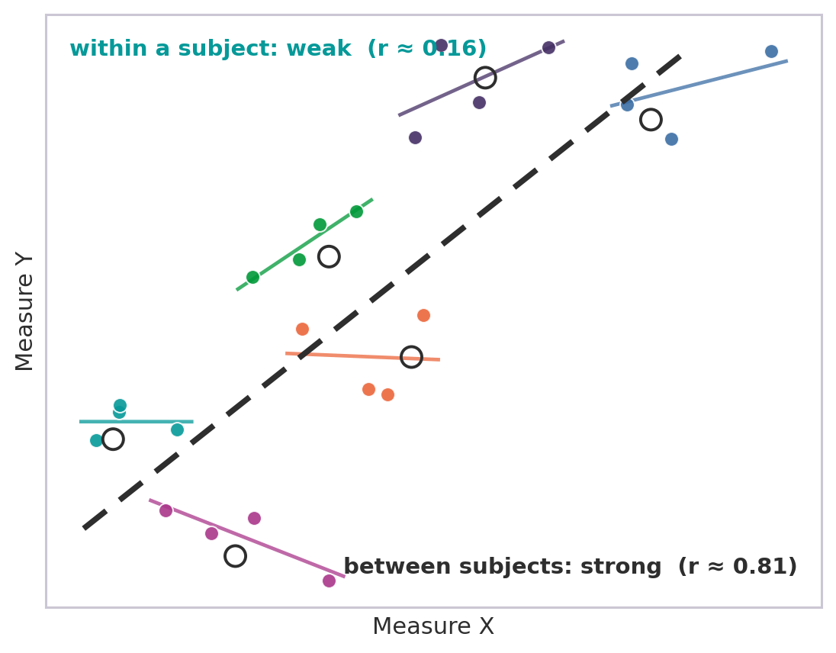
WITHIN & BETWEEN SUBJECTS · THE DISTINCTION
One dataset, three correlations
Total Across all rows, ignoring structure. Conflates both levels; do not interpret it on its own.
Between Based on the overall patient averages.
Do patients who score higher on X also tend to score higher on Y?
Within Among each patient’s deviations from their own mean.
When a patient rises above their usual X, does Y rise too?
WATCH OUT
These three types of correlations can differ in size, and sometimes in sign (Simpson’s paradox; Simpson, 1951).
Six patients with four visits each.
Subject means (open circles) rise together; most patient’s own cloud are barely associated
Volume 1 · Correlations · 1.0

Slide 31
WITHIN & BETWEEN SUBJECTS · WHY IT MATTERS
Two questions, two kinds of construct validity
When the question is whether an instrument detects change within a patient, the within-subject correlation, rather than the between-subject one, is the evidence for validity.
Between-subject
Within-subject
→ cross-sectional construct validity
→ longitudinal validity & responsiveness
Patients with worse disease report worse scores. Evidence: convergent and divergent correlations among patients.
When a patient’s disease worsens, their score worsens with it. Evidence: correlate within-patient change in the score with change in an anchor over time.
On regulation: FDA and EMA look for evidence of an instrument's ability to detect change, not only the ability to discriminate between patients. In theory, strong cross-sectional correlation should imply this; in practice, reviewers still expect to see the longitudinal correlation evidence.
Volume 1 · Correlations · 1.0

Slide 32

WITHIN & BETWEEN SUBJECTS · ESTIMATION
Three ways to separate the levels
With the ICC understood (ICC), choose how to separate the within- and between-subject associations:
Person-mean centering
rmcorr
Mixed-effects models
Subtract each person’s mean; any software. Within and between, separately.
One pooled within-subject estimate with a CI (R rmcorr). Assumes a common slope.
Each patient gets their own slope; can model AR(1) over time (lme4 / nlme).
Use as the transparent default.
Use for a single within answer.
Use when trajectories differ or data are autocorrelated (e.g. daily pain).
Decide which level answers your question before you look at the data.
The interpretation patterns are in the appendix.
Volume 1 · Correlations · 1.0

Slide 33
METHOD 1 OF 3
Person-mean centering
How it works
R · RUNS ON THE EXAMPLE DATASET
For each person, subtract their own mean from each observation. Correlate the centered scores for the within-subject association; correlate the person means for the between-subject one.
library(dplyr)
d <- adcorr %>%
filter(PARAMCD %in% c("FINTOX","SYMBUR")) %>%
pivot_wider(id_cols = c(USUBJID, AVISITN),
names_from = PARAMCD,
values_from = AVAL) %>%
group_by(USUBJID) %>%
mutate(fin_w = FINTOX - mean(FINTOX),
sym_w = SYMBUR - mean(SYMBUR)) %>%
ungroup()
cor(d$FINTOX, d$SYMBUR) # naive 0.54
cor(d$fin_w, d$sym_w) # within 0.23
Runs in any software, with no special package.
Gives within and between as separate, transparent numbers.
Needs three to four occasions per person; occasion-level missing data lowers precision.
IN PRACTICE
The most transparent approach (Curran & Bauer, 2011).
Volume 1 · Correlations · 1.0

Slide 34
METHOD 2 OF 3
Repeated-measures correlation (rmcorr)
How it works
R · RUNS ON THE EXAMPLE DATASET
Introduced by Bland & Altman (1995) and formalized as rmcorr (Bakdash & Marusich, 2017). It returns one within-subject correlation pooled across everyone, adjusting for non-independence by ANCOVA.
library(rmcorr)
# one within-subject correlation, pooled
# among patients, adjusting for
# non-independence (ANCOVA)
fit <- rmcorr(participant = USUBJID,
measure1 = FINTOX,
measure2 = SYMBUR,
dataset = as.data.frame(d))
fit$r # 0.23 fit$CI # 0.16 to 0.31
Gives a single within-subject r with a confidence interval.
Good when you want one clear within-subject answer.
WATCH OUT
rmcorr assumes a common within-subject slope. It does not estimate individual slopes and cannot model autocorrelation (no AR(1)). For those, use a mixed model.
Volume 1 · Correlations · 1.0

Slide 35
METHOD 3 OF 3
Mixed-effects models (lme4 / nlme)
How it works
R · RUNS ON THE EXAMPLE DATASET
A mixed model gives each patient their own intercept and slope, so patients can follow different trajectories over time. It can also model how residuals are correlated across closely spaced visits, for example an AR(1) structure.
library(nlme)
# random intercept per patient, AR(1) on
# the day-to-day residuals
ar1 <- corAR1(form = ~ AVISITN | USUBJID)
m <- lme(DIARY2 ~ DIARY1,
random = ~ 1 | USUBJID,
correlation = ar1, data = d)
cor(d$DIARY1, d$DIARY2) # naive 0.24
# within-person 0.54 AR(1) phi 0.42
Different trajectories: use it when patients’ within-subject slopes genuinely differ.
Autocorrelation: use it when closely spaced assessments, such as daily pain diaries, leave AR(1) residuals.
Sample size: random slopes and AR(1) add parameters, so they need enough patients and enough occasions each; with few of either, simplify the model.
READING THE OUTPUT
IN PRACTICE
The fixed slope for x is the within-subject association, interpret it on the same scale as r. The random-effects variances split total variability into between- and within-subject parts. The corAR1 parameter shows how strongly residuals are autocorrelated over time.
Reach for this when rmcorr’s single-slope, no-AR(1) assumptions are too restrictive.
Volume 1 · Correlations · 1.0

Slide 36
WITHIN & BETWEEN SUBJECTS · CASE STUDY
Financial toxicity and symptom burden
Synthetic study, realistic parameters. 38 oncology patients completed a financial-toxicity PRO and a symptom-burden measure at four monthly visits (152 observations). Levels separated by person-mean centering.
Level | r | Interpretation
Total (unadjusted) | 0.58 | Moderate, but which level does it reflect?
Between-subject | 0.71 | Patients with persistently higher financial toxicity report higher symptom burden.
Within-subject | 0.24 | Month-to-month changes in financial toxicity are only weakly linked to concurrent symptom changes (Simpson’s paradox).
KEY INSIGHT
Diverging results: the total (0.58) hides a strong between-subject link (0.71) and a weak within-subject one (0.24). For a trial of a financial intervention, the within-subject answer is the important one.
Volume 1 · Correlations · 1.0

Slide 37
WITHIN & BETWEEN SUBJECTS · WRAP-UP
Checklist and takeaways
BEFORE YOU REPORT A CORRELATION FROM REPEATED MEASURES
1
A correlation from nested data is a mixture of within and between. Decompose before interpreting.
State which correlation you mean: total, between, or within.
Account for the non-independence of repeated observations.
2
The two levels answer different questions and can even reverse in sign (Simpson’s paradox).
Use three to four occasions per subject for within-subject estimates.
Keep cross-sectional validity and longitudinal responsiveness distinct.
3
For individual-level responsiveness you need within-subject evidence; strong cross-sectional validity supports but doesn’t substitute.
Check whether within and between differ in size or reverse in sign.
Volume 1 · Correlations · 1.0

Slide 38
TOPIC 2 - APPENDIX
Within- and between-subject correlation
Depth, technical detail, and references
Volume 1 · Correlations · 1.0

Slide 39
APPENDIX · ASSUMPTIONS
Application conditions and assumptions
Sufficient occasions per subject. Within-subject estimates from only two timepoints are highly unstable. Three to four occasions are a practical minimum; power rises with both people and occasions (Bakdash & Marusich, 2017).
Adequate within-person variability. If a person’s scores barely move across occasions, there is no within-subject signal to detect. Distinguish a genuinely stable construct from measurement insensitivity.
Non-independence must not be ignored. Treating repeated observations as independent is an error, not a conservative choice: standard errors are wrong and confidence intervals misleadingly narrow.
Timing and spacing of assessments. Occasions must suit the construct and question. Too close may reflect carry-over; too far apart may capture change that obscures the association of interest.
Missing-data handling. Match the strategy to the method: FIML (Full Information Maximum Likelihood) for model-based approaches, careful occasion-level handling for person-mean centering. Pre-specify.
Volume 1 · Correlations · 1.0

Slide 40
APPENDIX · INTERPRETATION
Interpretation patterns
There are no universal magnitude thresholds for these decompositions. The question is whether within and between differ meaningfully from each other and from the total, and what that implies for the validity claim.
This framework applies only to repeated-measures data, a single cross-sectional correlation has no within-subject component to isolate.
Convergence
Divergence
Reversal
Within ≈ between ≈ total. The association is consistent across levels. Standard cross-sectional validity evidence is likely sufficient.
Between substantially larger than within (e.g. 0.71 vs 0.24). Captures stable differences well but is less sensitive to change; cross-sectional evidence overstates responsiveness.
Within and between differ in sign: a Simpson’s paradox. The aggregate association is entirely misleading about individual-level dynamics.
Generic pitfalls (treating repeated observations as independent, ecological-fallacy reasoning) are covered in Topic 5: Challenges and solutions.
Volume 1 · Correlations · 1.0

Slide 41
APPENDIX · REFERENCES
References
Slide 22 Cronbach, L. J., & Furby, L. (1970). How we should measure “change”: Or should we? Psychological Bulletin, 74(1), 68-80;
Hays, R. D., Farivar, S. S., & Liu, H. (2005). Approaches and recommendations for estimating minimally important differences for health-related quality of life measures. COPD, 2(1), 63–67;
Guyatt G. H. (2000). Making sense of quality-of-life data. Medical care, 38(9 Suppl), II175–II179.
Slide 30 Curran, P. J., & Bauer, D. J. (2011). The disaggregation of within-person and between-person effects in longitudinal models of change. Annu Rev Psychol, 62, 583-619.
Shrout, P. E., & Fleiss, J. L. (1979). Intraclass correlations: uses in assessing rater reliability. Psychol Bull, 86(2), 420-428;
Slide 29 Simpson, E. H. (1951). The interpretation of interaction in contingency tables. J R Stat Soc B, 13(2), 238-241.
Slide 30 FDA (2009). PRO Measures: Use in Medical Product Development to Support Labeling Claims;
FDA (2025). Patient-Focused Drug Development: Fit-for-Purpose COAs;
EMA (2016). Appendix 2, anticancer medicinal products: PRO measures in oncology.
Slide 34 Curran, P. J., & Bauer, D. J. (2011). The disaggregation of within-person and between-person effects in longitudinal models of change. Annu Rev Psychol, 62, 583-619.
Slide 33 Bland, J. M., & Altman, D. G. (1995). Calculating correlation coefficients with repeated observations. BMJ, 310, 446;
Bakdash, J. Z., & Marusich, L. R. (2017). Repeated measures correlation. Front Psychol, 8, 456.
Volume-wide further reading:
Bates, D., et al. (2015). Fitting linear mixed-effects models using lme4. J Stat Softw, 67(1), 1-48;
Pinheiro, J. C., & Bates, D. M. (2000). Mixed-Effects Models in S and S-PLUS. Springer.
Volume 1 · Correlations · 1.0

Slide 42
TOPIC 3
Types of correlation
Matching the coefficient to the data and the question
Volume 1 · Correlations · 1.0

Slide 43
TYPES OF CORRELATION · WHY FORMS DIFFER
Match the coefficient to the data
The right coefficient depends on how each variable is measured. A correlation is a model-based summary; the wrong choice attenuates or distorts the association.
This framework assumes every patient answered the same fixed item set.
 | Continuous | Ordinal | Binary
Continuous | Pearson / Spearman | Polyserial / Spearman | Point-biserial / Biserial
Ordinal | Polyserial | Polychoric / Spearman | Polychoric¹
Binary | Point-biserial / Biserial | Polychoric¹ | Tetrachoric / Phi
Interpreting the matrix
Find your two data types on the edges; the cell names the coefficient. Continuous–continuous is the familiar Pearson / Spearman case; the other cells handle ordinal and binary data.
¹ a binary variable treated as a two-level ordinal (e.g. via the psych package in R).
IN PRACTICE
Different correlation coefficients answer different measurement questions:
Pearson summarizes linear observed-score association,
Spearman summarizes monotonic rank-based association,
polychoric/polyserial correlations estimate latent associations under threshold assumptions
In COA work, many variables are ordinal or binary observations of continuous health concepts, so the latent-variable coefficients (polychoric, polyserial, biserial) matter. For agreement on continuous repeated measures, use the ICC.
IN OTHER WORDS
Volume 1 · Correlations · 1.0

Slide 44
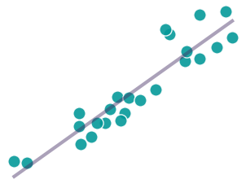
PRIMER · CONTINUOUS DATA
Pearson correlation (r)
continuous × continuous
WHAT IT IS
KEY LIMITS
A standardized measure of the linear association between two continuous variables.
Assumes interval-level measurement and linearity.
Sensitive to outliers, non-linearity, and measurement error.
Attenuates associations when variables are ordinal.
UNDER THE HOOD
Pearson divides the covariance of the two variables by the product of their standard deviations. That standardisation makes it scale-free and bounded by −1 to +1.
R · RUNS ON THE EXAMPLE DATASET
EXAMPLE COA USES
# CDISC BDS is long: pivot to wide first
library(dplyr); library(tidyr)
wide <- adcorr %>%
filter(AVISIT == "Baseline") %>%
pivot_wider(id_cols = USUBJID,
names_from = PARAMCD, values_from = AVAL)
cor(wide$TARGTOT, wide$RELATEDA) # 0.73
Convergent validity between numeric or visual-analogue scales, or domain / total scores.
Associations between change scores (responsiveness).
Volume 1 · Correlations · 1.0

Slide 45
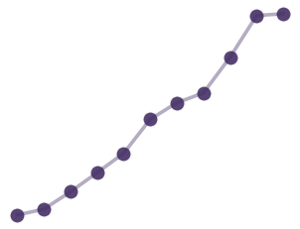
PRIMER · ORDINAL OR NON-NORMAL DATA
Spearman rank correlation (ρ)
ranked values
WHAT IT IS
KEY LIMITS
A correlation computed on the ranked values of two variables, not their raw scores. It’s a non-parametric statistic.
No variance-based interpretation, unlike Pearson.
Still attenuates when responses collapse into a few broad categories.
Kendall’s τ is an alternative for small samples or many ties (reliability).
UNDER THE HOOD
Spearman replaces each value with its rank, then applies the Pearson formula to those ranks. So it captures any monotonic relationship, not just a straight line.
R · RUNS ON THE EXAMPLE DATASET
# same wide layout as Pearson
cor(wide$ITEM02, wide$ITEM03,
method = "spearman") # 0.62
# Kendall alternative for many ties:
cor(wide$ITEM02, wide$ITEM03,
method = "kendall") # 0.55
EXAMPLE COA USES
Item–item relationships for ordinal or non-normal variables.
Ordinal anchors (PGIS, CGIS) when a latent model (see next) is not needed. The decision not to use a latent variable needs to be justified.
Robustness checks alongside Pearson.
Volume 1 · Correlations · 1.0

Slide 46
PRIMER · ORDINAL vs CONTINUOUS (LATENT) DATA
Polyserial correlation
continuous × ordinal
WHAT IT IS
KEY LIMITS
A correlation method for one continuous and one ordinal variable, assuming the ordinal variable reflects an underlying continuous latent variable with thresholds.
.
Relies on latent normality and threshold assumptions for the ordinal variable
Sensitive to sparse or highly skewed response categories
More complex to estimate than Pearson or Spearman correlations (requires additional assumptions and specialized estimation methods)
Reflects a model‑based association, not a directly observed relationship
UNDER THE HOOD
Polyserial correlation corresponds to the correlation between the observed continuous variable and a latent continuous variable underlying the ordinal measure (not the correlation between observed scores).
R · RUNS ON THE EXAMPLE DATASET
EXAMPLE COA USES
library(polycor)
# ordinal PGIS against continuous TARGTOT
polyserial(wide$TARGTOT, wide$PGIS) # 0.72
#Compare vs Pearson
cor(wide$TARGTOT, wide$PGIS) # 0.68
Item–domain or item–total relationships (ordinal item vs continuous score, corrected item-total correlation)
Ordinal anchors (e.g., PGIS, PGIC) vs continuous endpoints.
Convergent validity where constructs are assessed using mixed measurement scales
Volume 1 · Correlations · 1.0

Slide 47
PRIMER · ORDINAL vs ORDINAL (LATENT-LATENT) DATA
Polychoric correlation
ordinal × ordinal
WHAT IT IS
KEY LIMITS
A correlation method for two ordinal variables, assuming each reflects an underlying continuous latent variable with thresholds.
.
Relies on latent normality and threshold assumptions
Sensitive to sparse categories or skewed distributions
More complex to estimate and interpret than Pearson/Spearman (requires additional assumptions and specialized estimation methods)
Reflects a model-based association, not directly observed relationships
UNDER THE HOOD
Correlation between the latent continuous variables (not the correlation between observed categories).
R · RUNS ON THE EXAMPLE DATASET
EXAMPLE COA USES
library(polycor)
# two ordinal items, same wide layout
polychor(wide$ITEM02, wide$ITEM03) # 0.71
# full item matrix (psych package):
psych::polychoric(
wide[, c("ITEM02", "ITEM03")])$rho
Item–item relationships for ordinal response scales
Used in the underlying correlation matrix in EFA and CFA (must be specified in code)
Volume 1 · Correlations · 1.0

Slide 48
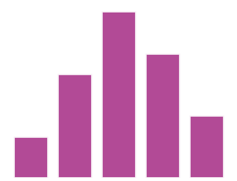
PRIMER · ORDINAL AND BINARY DATA
Coefficients for ordinal and binary data
ordinal categories
Coefficient | Variables | Assumes Latent variable | Typical COA use
Point-biserial | binary (true) × continuous | No (Pearson case) | group or sex × score; item correct × total
Biserial | binary (dichotomized) × continuous | Yes | an artificially split continuous variable × score (e.g. a median split. Note: never use a median split)
Polychoric | ordinal × ordinal | Yes (both) | Likert item × item; input to factor analysis
Polyserial | ordinal × continuous | Yes (ordinal) | ordinal item × total or continuous score
Tetrachoric | binary × binary | Yes (both) | two dichotomous items
KEY INSIGHT
R · RUNS ON THE EXAMPLE DATASET
The latent-model coefficients estimate the correlation between the assumed underlying continuous variables, so they recover what Pearson attenuates on coarse categories. This is central for ordinal Likert items.
library(psych)
cor(wide$TARGTOT, wide$SEVGRP) # 0.46
cor(wide$TARGTOT, wide$DICHOTOM) # 0.37
biserial(wide$TARGTOT, wide$DICHOTOM) # 0.48
Volume 1 · Correlations · 1.0

Slide 49
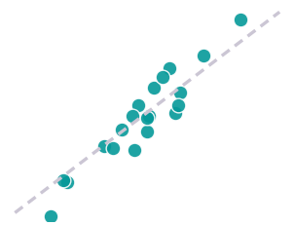
TYPES OF CORRELATION · A SPECIAL CASE
The use and abuse of the ICC
repeated measures
The ICC is a correlation for repeated measurements, built from the same standardized-covariance idea but answering a different question.
STATE ITS FORM, OR IT IS AMBIGUOUS
Model: one-way vs two-way (are raters or occasions random?)
Definition: absolute agreement vs consistency.
Unit: a single measure vs the average of several.
Grand mean: the overall average across all people and all their measurements (a group-level reference, not each person’s own mean).
ICC = 0.87” alone cannot be interpreted. Shrout & Fleiss (1979); McGraw & Wong (1996).
REUSABLE CONCLUSION: "Test–retest reliability was good: ICC = 0.87 (95% CI 0.83, 0.90), two-way random-effects model, absolute agreement, single measures.
The ICC asks: when one of a person’s measurements sits above (or below) the grand mean, do their other measurements too? It partitions the total variance into between-person and within-person parts.
R · RUNS ON THE EXAMPLE DATASET
General definition: the ICC quantifies the proportion of total variance attributable to differences between individuals. Equivalently, it describes the extent to which repeated measurements or ratings from the same person remain similar.
# wide: rows = subjects, one column per visit
retest <- adcorr %>%
filter(PARAMCD == "TARGTOT", AVISITN < 12) %>%
pivot_wider(id_cols = USUBJID,
names_from = AVISIT, values_from = AVAL)
psych::ICC(retest[, -1]) # ICC(2,1) 0.87
Therefore it suits test–retest, inter-rater and intra-rater reliability, and nested data (Topic 2).
Volume 1 · Correlations · 1.0

Slide 50
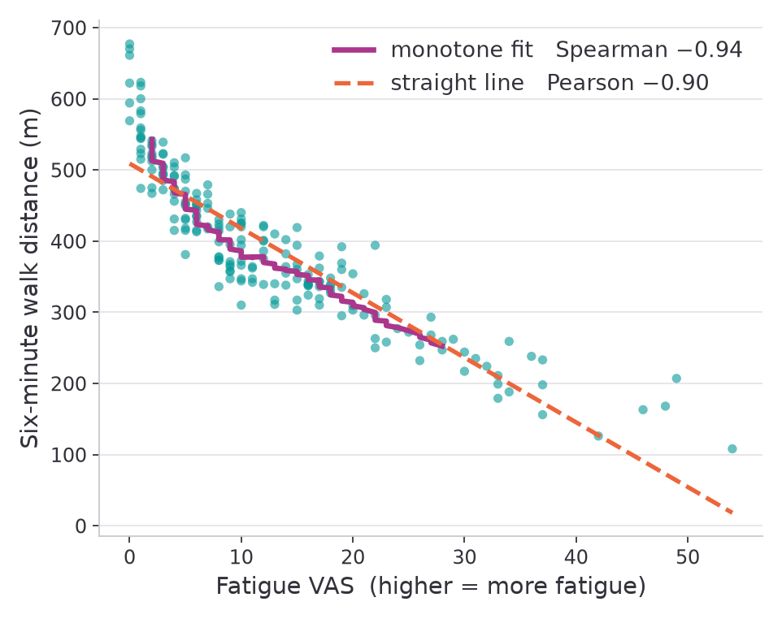
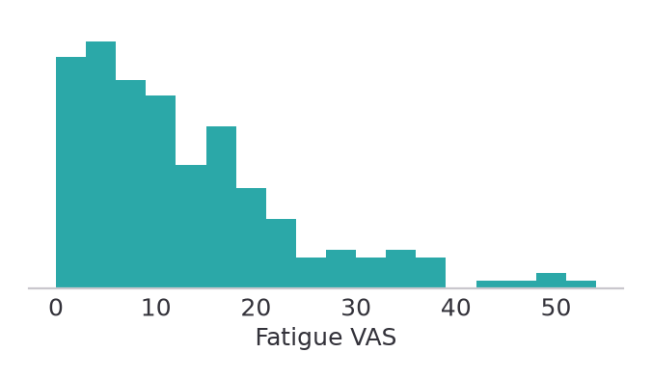
THE IMPACT · EXAMPLE 1
Curved and skewed: Pearson underestimates the relationship
THE DATASET
200 patients: a fatigue VAS against six-minute walk distance. More fatigue goes with less walking. The relationship is strong but curved, and the VAS is right-skewed.
IN PRACTICE
With a monotonic but non-linear relationship, report Spearman; Pearson is pulled down by the curvature, not by a weak association.
Note: FDA often asks for Spearman correlations to be reported.
Pearson r = −0.90 already reads as strong, but Spearman ρ = −0.94 shows the monotonic association is stronger still.
Volume 1 · Correlations · 1.0

Slide 51
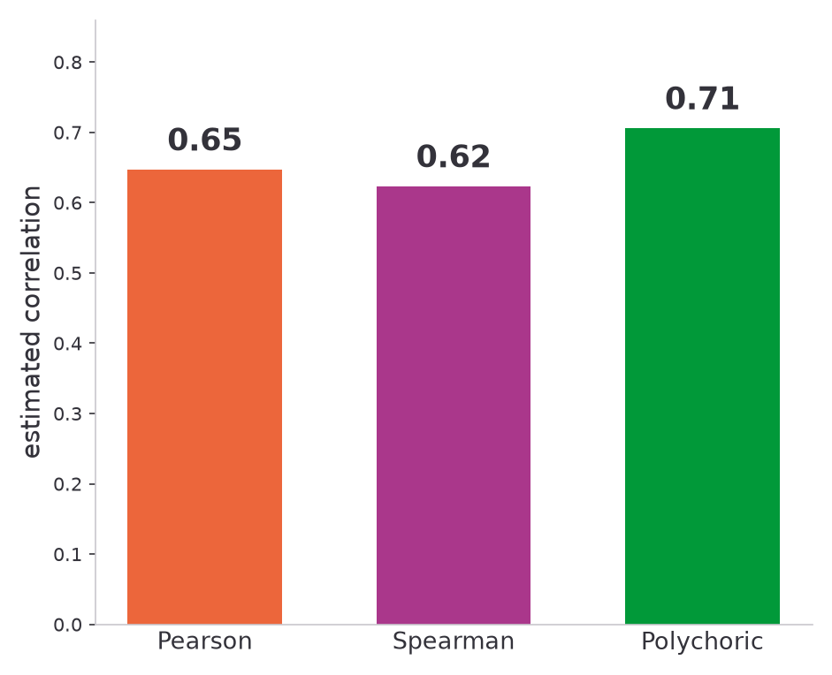
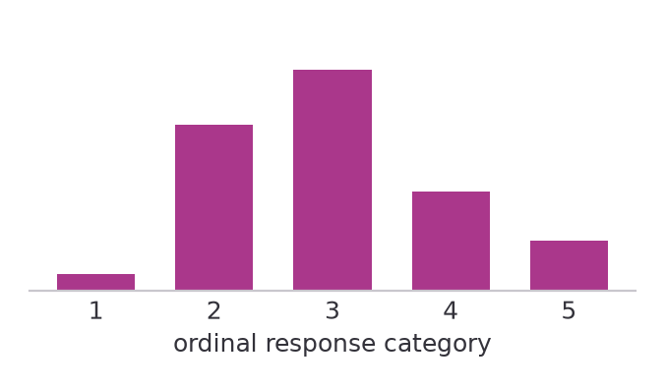
THE IMPACT · EXAMPLE 2
Coarse ordinal data: polychoric recovers the signal
THE DATASET
Two 5-point Likert items from the same domain, n = 200. Responses spread across all five categories, with the middle ones used most.
IN PRACTICE
On few ordinal categories, Pearson and Spearman attenuate; polychoric estimates the correlation between the underlying constructs. It is the best default here, not an exact answer everywhere.
Note: ordinal response coding, 1 to 5, is a convention to analyze the data, there is no inherent value to these numeric values.
Pearson 0.65 and Spearman 0.62 attenuate the association. Polychoric recovers it, returning 0.71 against a true value of 0.71.
Volume 1 · Correlations · 1.0

Slide 52
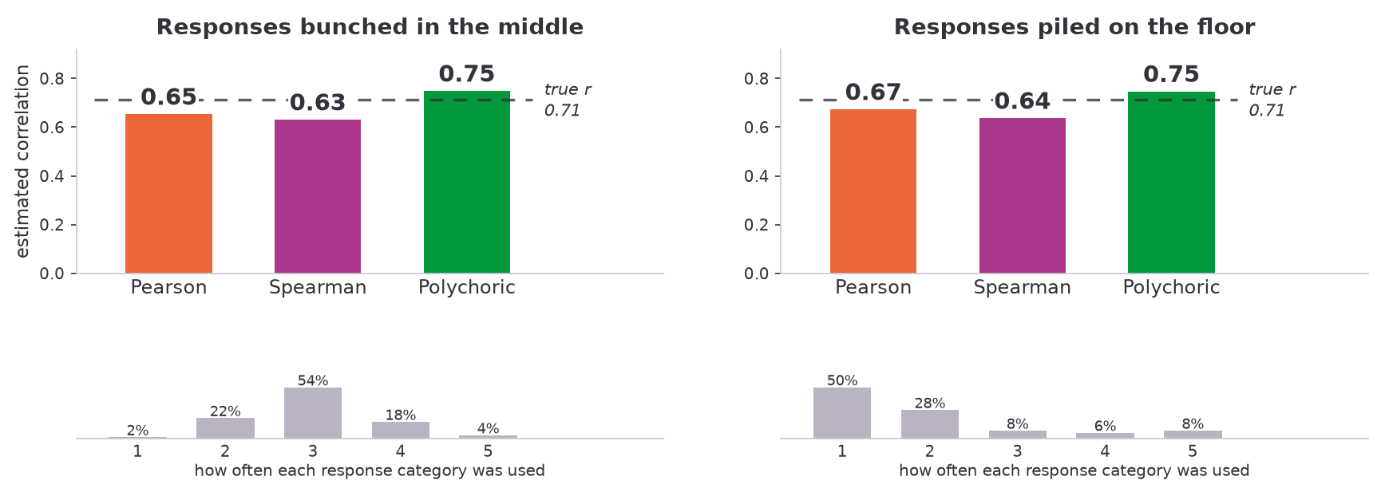
TYPES OF CORRELATION · THE SAME ITEMS, DIFFERENT SHAPES
When responses bunch up, polychoric still wins,
but it starts to overshoot too
The same four items and the same latent truth as the previous slide, redrawn under two response distributions clinicians meet constantly. Polychoric stays the closest of the three, but both shapes push it above the true 0.71.
Volume 1 · Correlations · 1.0

Slide 53
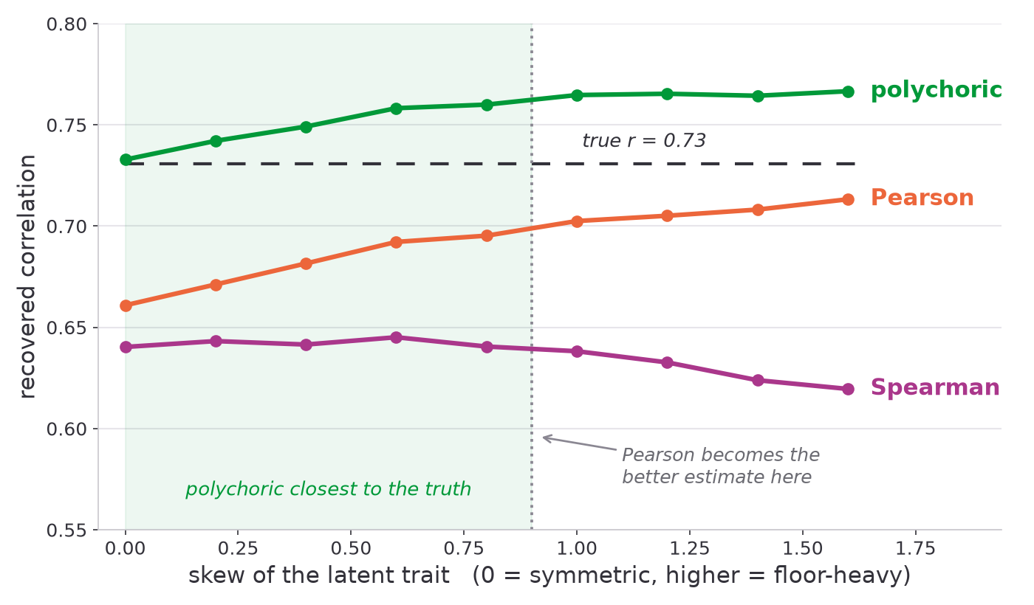
TYPES OF CORRELATION · STRESS TEST
Does the right coefficient always recover the truth?
Each coefficient was asked to recover a known underlying correlation (r ≈ 0.73) from 5-point items, as the latent trait shifts from symmetric to floor-heavy, the shape symptom data can often take in real patients.
POLYCHORIC
Recovers the underlying correlation when responses are near-symmetric. Stays closest to it across mild skew. The only one of the three that targets the latent association.
PEARSON
Attenuated when the latent trait is near-normal, but de-attenuates as the distribution skews. Past a skew of about 0.9 it becomes the closer estimate. Its error is not constant.
SPEARMAN
Never recovers the latent correlation, sitting near 0.63 throughout. It answers a rank-based question, so if used to estimate an inter-item or latent r it will produce a conservative estimate.
n = 200 · 5-point items · true latent r ≈ 0.73 · mean of 500 simulations per skew level. Polychoric is the safest default, but no single coefficient is unconditionally exact.
Volume 1 · Correlations · 1.0

Slide 54
TYPES OF CORRELATION · TAKEAWAYS
Five things to carry forward
Match coefficient to data
Choose by scale, information content, and whether the variable is observed or latent.
Pearson vs Spearman
Pearson for linear continuous; Spearman for monotonic, ordinal, or non-normal data.
Recover the latent correlation
For ordinal and binary data, polychoric / polyserial / biserial / tetrachoric avoid attenuation. This matters for Likert items.
State the ICC’s form
The ICC is a correlation for repeated measures and agreement; name the model, definition, and unit.
It can change the conclusion
The wrong coefficient matters most with few categories, skew, or latent constructs.
Volume 1 · Correlations · 1.0

Slide 55
APPENDIX · REFERENCES
References
Slide 45 Spearman, C. (1904). The proof and measurement of association between two things. Am J Psychol, 15, 72-101.
Slide 49 Shrout, P. E., & Fleiss, J. L. (1979). Intraclass correlations: uses in assessing rater reliability. Psychol Bull, 86(2), 420-428;
McGraw, K. O., & Wong, S. P. (1996). Forming inferences about some intraclass correlation coefficients. Psychol Methods, 1(1), 30-46.
Volume-wide further reading:
Revelle, W. (2024). psych: Procedures for Psychological, Psychometric, and Personality Research. R package (polychoric, ICC).
Olsson, U. (1979). Maximum likelihood estimation of the polychoric correlation coefficient. Psychometrika, 44, 443-460.
Volume 1 · Correlations · 1.0

Slide 56
TOPIC 4
Correlation outputs
Showing, estimating, and interpreting a correlation
Volume 1 · Correlations · 1.0

Slide 57
CORRELATION OUTPUTS · OVERVIEW
What a correlation report needs
Three things that should be presented together. A correlation coefficient on its own will lack important context.
A picture
An estimate with a CI
A benchmarked reading
Plot the data before you trust the number.
Report r with a 95% confidence interval.
Judge the size against a pre-specified benchmark. (R²)
Scatter plots and related displays.
Precision, not just a point value.
In the context of the measurement purpose.
Statistical significance is rarely the answer; the size of the correlation and the precision around it are whats important to the interpretation.
Volume 1 · Correlations · 1.0

Slide 58
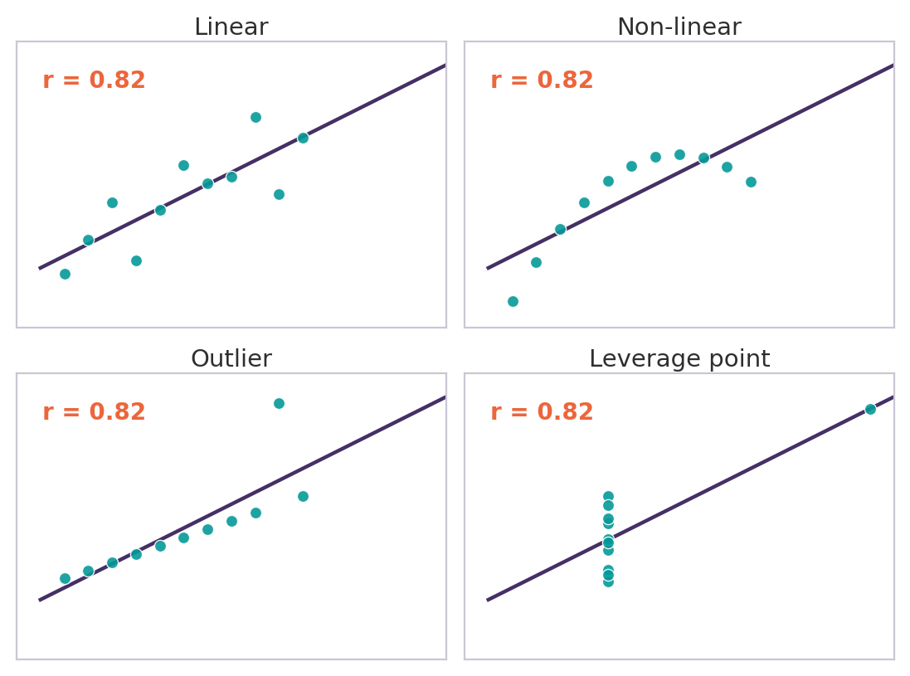
GRAPHICAL OUTPUTS · PLOT FIRST
Always plot before you trust the number
A single r can hide
Non-linear relationships that r reads as weak.
Outliers or leverage points that create or mask a correlation.
Range restriction that shrinks r.
Subgroups or clusters posing as one association.
The next four slides: the plots that help add context – scatter, correlation matrix, Bland–Altman, and spaghetti.
KEY INSIGHT
The coefficient is a summary. The real evidence is the plot we made along the way.
Anscombe’s quartet: four datasets, all with r = 0.82 (Anscombe, 1973).
Volume 1 · Correlations · 1.0

Slide 59
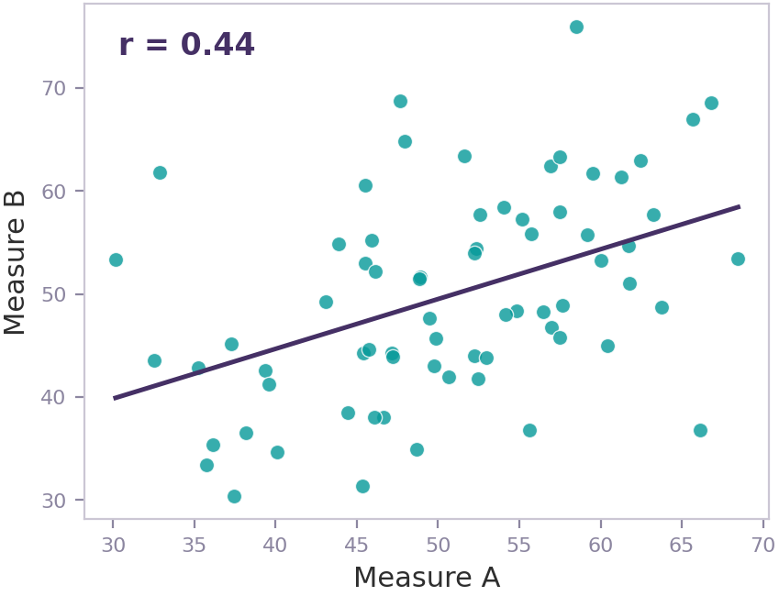
GRAPHICAL OUTPUTS · SCATTER PLOT
Scatter plot: the default for two continuous measures
WHAT IT SHOWS
The form of the relationship – linear, curved, or none – all at a glance.
Outliers and leverage points, spread, and clustering.
Simply put - whether a single r is a fair summary of the cloud.
R · RUNS ON THE EXAMPLE DATASET
library(ggplot2)
# wide: one row per subject
ggplot(wide, aes(TARGTOT, RELATEDA)) +
geom_point(alpha = 0.6) +
geom_smooth(method = "lm")
Volume 1 · Correlations · 1.0

Slide 60
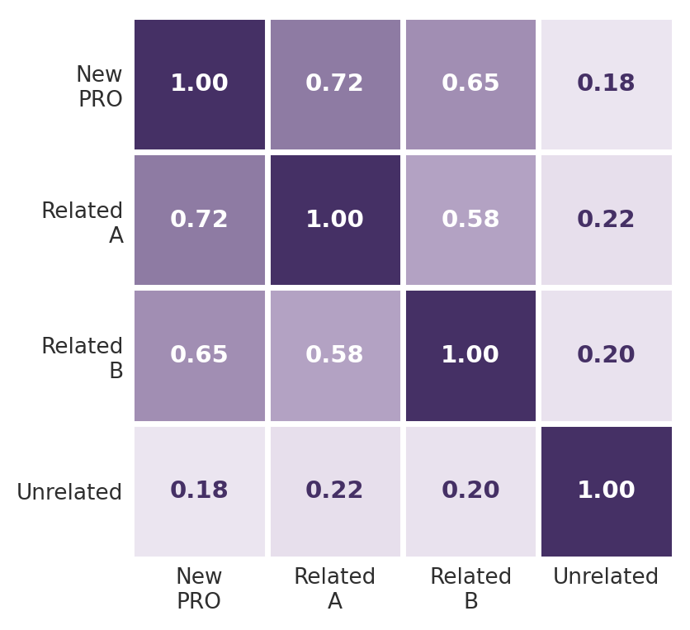
GRAPHICAL OUTPUTS · CORRELATION MATRIX
Correlation matrix: every pair at once
WHAT IT SHOWS
Every pairwise correlation in a set of items or scales, as a heat map.
Convergent blocks (high) and divergent patterns (low) stand out at once.
The usual first look at a multi-item or multi-domain COA.
R · RUNS ON THE EXAMPLE DATASET
library(corrr)
wide %>%
select(TARGTOT, RELATEDA,
RELATEDB, UNRELATD) %>%
correlate() %>% shave() %>% fashion()
Volume 1 · Correlations · 1.0

Slide 61
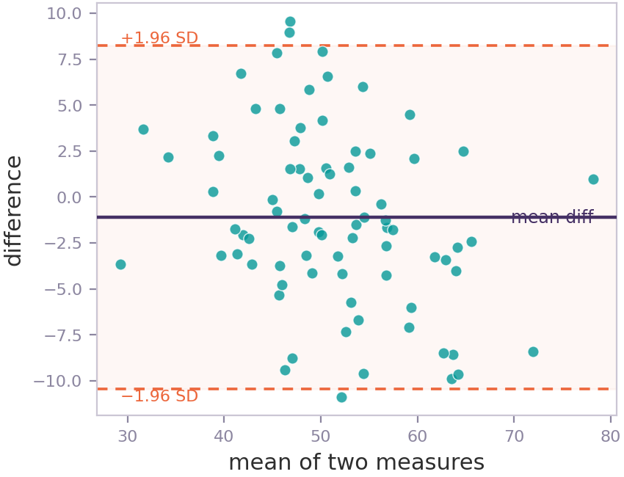
GRAPHICAL OUTPUTS · BLAND–ALTMAN
Bland-Altman: agreement, not just association
Bland-Altman requires continuous data
WHAT IT SHOWS
Agreement between two methods or occasions: the difference plotted against the mean.
Limits of agreement (mean difference ± 1.96 SD each with its own 95%CI) show how far paired measurements fall apart.
A high correlation can still hide systematic bias butthis plot can help reveals. Pairs well with a good cup of tea and the ICC (Topic 2).
R · RUNS ON THE EXAMPLE DATASET
library(blandr)
# paired measurements per subject
blandr.draw(retest$Baseline, retest$Retest)
# bias 0.60 limits -13.9 to 15.1
Volume 1 · Correlations · 1.0

Slide 62
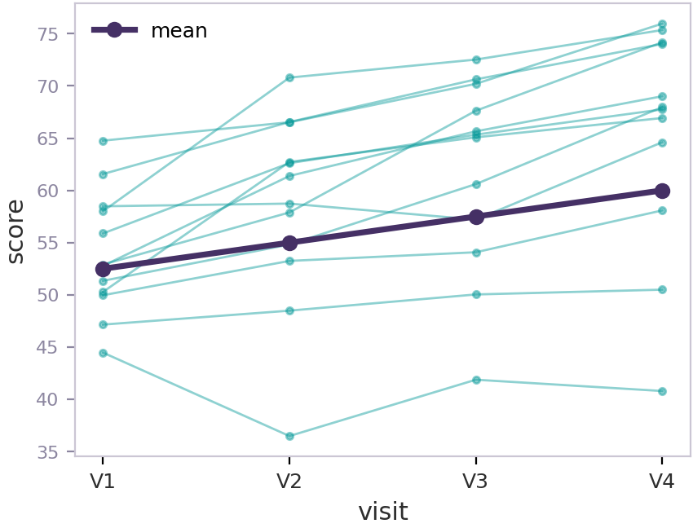
GRAPHICAL OUTPUTS · SPAGHETTI PLOT
Spaghetti plot: individual change over time
WHAT IT SHOWS
Each subject’s trajectory across visits, with the mean overlaid.
Heterogeneity and individual change that a single correlation cannot show.
A useful look before within / between modeling (Topic 2).
R · RUNS ON THE EXAMPLE DATASET
# CDISC BDS is already long: plot directly
library(ggplot2)
adcorr %>%
filter(PARAMCD == "SYMBUR") %>%
ggplot(aes(AVISITN, AVAL, group = USUBJID)) +
geom_line(alpha = 0.25) +
stat_summary(aes(group = 1), fun = mean,
geom = "line", linewidth = 1.4)
Volume 1 · Correlations · 1.0

Slide 63
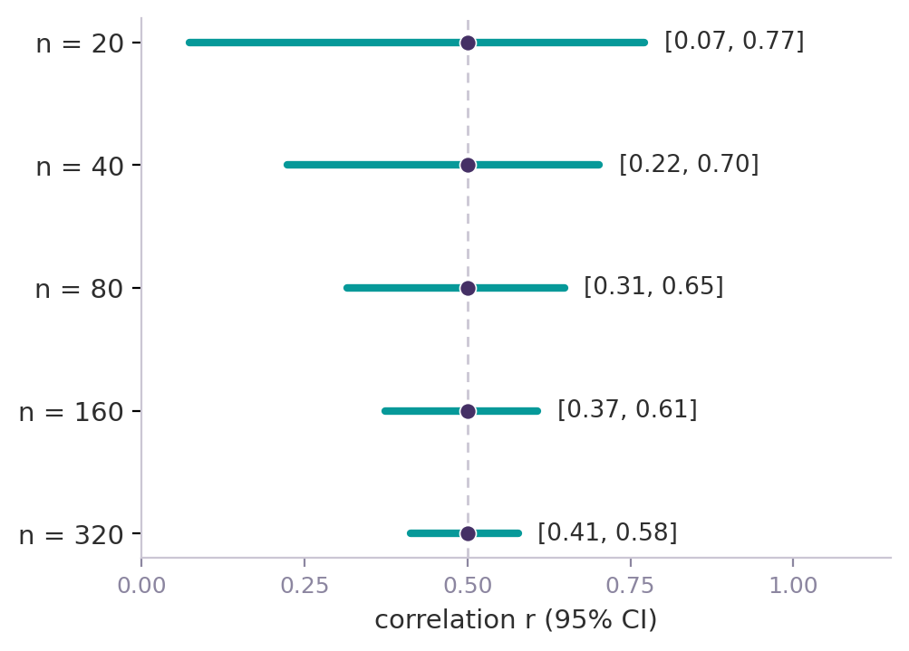
TABLES · CONFIDENCE INTERVALS
Report the estimate with a confidence interval
A confidence interval shows how precise the estimate is, which a lone r hides.
Its width depends on the sample size, and on r itself (Fisher, 1921).
Report r with its 95% CI in every correlation table.
REPORTING TEMPLATE
r = 0.52 (95% CI [0.41 ; 0.61]), n = 180.
IN PRACTICE
The 95% CI for r = 0.5 narrows as the sample grows.
Non-overlapping 95% CIs indicate a real difference between two correlations. However overlapping CIs do not rule one out. A CI-for-the-difference is narrower than the eye suggests.
If needed, two correlations can be formally compare to test the difference directly (Fisher z for independent samples; Steiger's test for dependent ones).
Volume 1 · Correlations · 1.0

Slide 64
TABLES · SIGNIFICANCE
Why we rarely use significance tests
A significance test for a correlation asks only whether r differs from exactly zero. In COA work that is almost never the question.
WATCH OUT
A p-value rewards sample size, not just measurement quality (as it is partially a function of sample size). A large, precisely estimated correlation and a tiny one can carry the same p-value.
With large samples, almost any correlation is “significant”, even a trivial one.
With small samples, a clinically meaningful correlation can be “non-significant”.
The useful questions (is it large enough, precise enough, as hypothesized?) are answered by the magnitude and the CI, not the p-value.
IN PRACTICE
pre-specify the magnitude you need and report the estimate with its CI. If a p-value appears at all, keep it as secondary.
Volume 1 · Correlations · 1.0

Slide 65
INTERPRETING RESULTS · THRESHOLDS
Threshold benchmarks: a history, and a caution
There is no universal standard for a “weak” or “strong” correlation. Several conventions exist, and they disagree.
Convention | Interpretation bands for |r|
Cohen (1988) | 0.10 small · 0.30 medium · 0.50 large
Schober et al. (2018) | <0.10 negligible · 0.10–0.39 weak · 0.40–0.69 moderate · 0.70–0.89 strong · ≥0.90 very strong
Hinkle et al. (2003) / Mukaka (2012) | <0.30 negligible · 0.30–0.49 low · 0.50–0.69 moderate · 0.70–0.89 high · ≥0.90 very high
KEY INSIGHT
These began as general rules of thumb, not COA-specific laws. The same r can be “moderate” in one system and “weak” in another. Choose and justify one in advance, and interpret it against the measurement purpose, not as a verdict. Higher thresholds could be used where a method effect is thought to exist (two PROs completed in the same session) whereas more lenient values could be used when considering mixed modality correlations (PRO versus clinician administered performance-based outcome or a passively recorded digital measure). Typically, the more conservative estimates are expected by reviewers without a strong rationale
Volume 1 · Correlations · 1.0

Slide 66
INTERPRETING RESULTS · PROPERTIES
Benchmarks for evaluating psychometric properties
Property | What you correlate | Common benchmark for |r| (full references in appendix)
Internal consistency | average inter-item r | 0.15–0.50 (Clark & Watson, 1995); 0.20–0.40 (Piedmont, 2014)
Item quality | corrected item–total r | ≥0.30 (Nunnally, 1994); ≥0.40 (Fayers & Machin, 2015)
Test–retest / inter-rater | ICC | ≥0.70 acceptable; 0.75–0.90 good (COSMIN; Koo & Li, 2016; Cicchetti, 1994)
Convergent / divergent | r with a criterion | ≥0.50 convergent; <0.30 divergent (COSMIN; Cappelleri, 2013)
Responsiveness | change r | ≥0.30 (COSMIN; Revicki, 2008)
Anchor selection | change r with anchor | ≥0.30 (Revicki, 2008; Hays, 2005); ≥0.50 ROC (Devji, 2020; Griffiths, 2023)
What are COSMIN bands? Several thresholds above cite COSMIN (COnsensus-based Standards for the selection of health Measurement INstruments), an international initiative that defines quality criteria and rating thresholds for measurement properties, widely used as default benchmarks in PRO validation. The full reference for every citation above is given in the appendix. Where COSMIN guidance exists, this is generally the preferred threshold to adopt. However, in absence of this, the more conservative threshold is typically recommended without a strong rationale to do otherwise.
Volume 1 · Correlations · 1.0

Slide 67
TABLES · REPORTING
Tabulating correlation results
Put the coefficient and its interval first; keep p-values secondary or omit them. Plots should support throughout.
Comparison | r | 95% CI | n
Total score × global VAS (convergent) | 0.62 | 0.54 to 0.69 | 180
Domain A × Domain B (convergent) | 0.45 | 0.34 to 0.55 | 180
Total score × unrelated scale (divergent) | 0.11 | −0.03 to 0.25 | 180
Change in total × PGIC anchor (responsiveness) | 0.38 | 0.25 to 0.50 | 150
FORMATTING
Report r to two decimals with its 95% CI and n.
Group convergent and divergent pairs together.
State the hypothesized direction for each pair.
  This can be added a a column to a results table
Keep any p-values in a secondary column, or omit.
Volume 1 · Correlations · 1.0

Slide 68
CORRELATION OUTPUTS · TAKEAWAYS
Five things to carry forward
Plot before you trust
The same r can come from very different data; the picture is the evidence. Scatter, matrix, Bland–Altman, and spaghetti each reveal something r hides.
Report r with a CI
A confidence interval shows the precision a single value hides.
Significance is rarely the point
Size and precision answer the real questions, not the p-value.
Benchmarks are conventions
No universal standard exists; pre-specify and justify the one you use.
Match the benchmark to the property
Internal consistency, reliability, validity, responsiveness, and anchors each have their own.
Volume 1 · Correlations · 1.0

Slide 69
APPENDIX · REFERENCES
References
Slide 58 Anscombe, F. J. (1973). Graphs in statistical analysis. Am Stat, 27(1), 17-21.
Slide 61 Bland, J. M., & Altman, D. G. (1986). Statistical methods for assessing agreement between two methods of clinical measurement. Lancet, 327, 307-310.
Slide 63 Fisher, R. A. (1921). On the probable error of a coefficient of correlation deduced from a small sample. Metron, 1, 3-32.
Slide 65 Cohen, J. (1988). Statistical Power Analysis for the Behavioral Sciences (2nd ed.). Erlbaum;
Schober, P., Boer, C., & Schwarte, L. A. (2018). Correlation coefficients: appropriate use and interpretation. Anesth Analg, 126(5), 1763-1768;
Hinkle, D. E., Wiersma, W., & Jurs, S. G. (2003). Applied Statistics for the Behavioral Sciences (5th ed.);
Houghton Mifflin. Mukaka, M. M. (2012). A guide to appropriate use of correlation coefficient in medical research. Malawi Med J, 24(3), 69-71.
Slide 66 Clark, L. A., & Watson, D. (1995). Constructing validity: Basic issues in objective scale development. Psychological Assessment, 7(3), 309–319;
Piedmont, R.L. (2014). Inter-item Correlations. In: Michalos, A.C. (eds) Encyclopedia of Quality of Life and Well-Being Research. Springer, Dordrecht;
Nunnally, J. C., & Bernstein, I. H. (1994). Psychometric Theory (3rd ed.). McGraw-Hill;
Fayers, P. M., & Machin, D. (2015).Quality of life: the assessment, analysis and reporting of patient-reported outcomes; John Wiley & Sons;
Koo, T. K., & Li, M. Y. (2016). A Guideline of Selecting and Reporting Intraclass Correlation Coefficients for Reliability Research. Journal of chiropractic medicine, 15(2), 155–163;
Cicchetti, D. V. (1994). Guidelines, criteria, and rules of thumb for evaluating normed and standardized assessment instruments in psychology. Psychological Assessment, 6(4), 284–290;
Prinsen, C. A. C., et al. (2018). COSMIN guideline for systematic reviews of PROMs. Qual Life Res, 27, 1147-1157;
Cappelleri, J. C., et al. (2013). Patient-Reported Outcomes: Measurement, Implementation and Interpretation. CRC Press;
Revicki, D., et al. (2008). Determining responsiveness and minimally important differences for PROs. J Clin Epidemiol, 61(2), 102-109;
Hays, R. D., Farivar, S. S., & Liu, H. (2005). Approaches and recommendations for estimating minimally important differences for health-related quality of life measures. COPD, 2(1), 63–67;
Coon, C. D., & Cappelleri, J C. (2016). Interpreting change in scores on PRO instruments. Ther Innov Regul Sci, 50(1), 22-29;
Devji, T., et al. (2020). Credibility of anchor-based estimates of minimal important differences. BMJ, 369, m1714;
Griffiths, P., Sims, et al., (2023). How strong should my anchor be for estimating group and individual level meaningful change? A simulation study assessing anchor correlation strength and the impact of sample size, distribution of change scores and methodology on establishing a true meaningful change threshold. Quality of Life Research, 32(5), 1255-1264. (simulation).
Volume 1 · Correlations · 1.0

Slide 70
TOPIC 5
Challenges and solutions
What distorts a correlation, and what to do about it
Volume 1 · Correlations · 1.0

Slide 71
CHALLENGES · OVERVIEW
What can distort a correlation
Even the right coefficient on the right question can mislead if the data work against it. The common threats, and where they bite:
Too few subjects
Missing data
Restricted range, floor / ceiling
Unstable estimate, wide CIs
Biased or inconsistent estimate
Attenuated correlation
Measurement error
Recall bias
Change vs cross-sectional
Attenuated correlation
Distorted anchor or rating
Not directly comparable
Most fixes are about design and reporting, not a cleverer coefficient.
Volume 1 · Correlations · 1.0

Slide 72
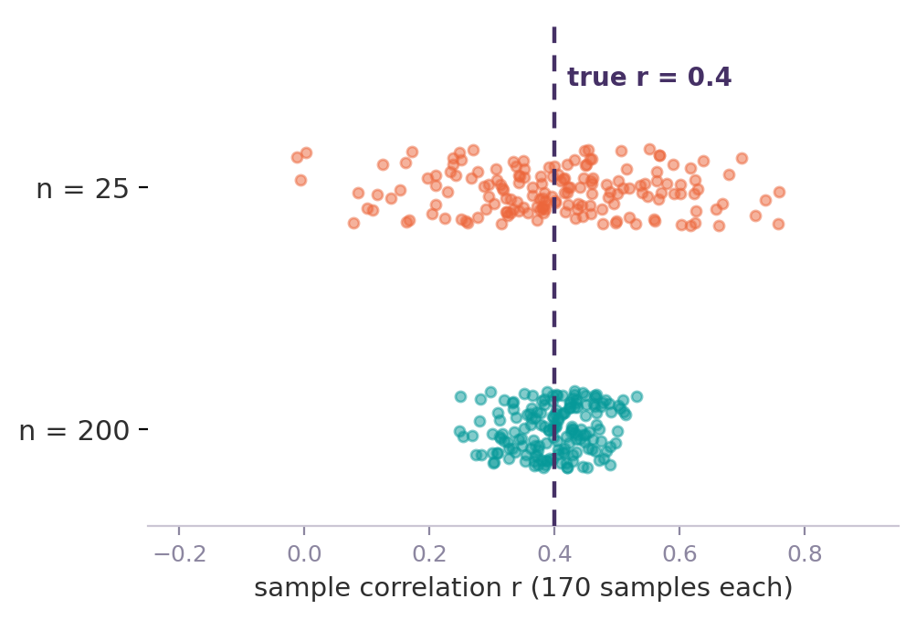
CHALLENGE · SAMPLE SIZE
Too few subjects, too much noise
A small sample gives an unstable r that can be far from the true value.
Confidence intervals are wide, so small studies rarely distinguish one correlation from another.
There is no universal minimum, but precision improves steadily with n (Schönbrodt & Perugini, 2013).
WHAT TO DO
Plan for the precision you need around the expected r, not just for a statistically significant result. Report confidence intervals and treat correlations from small samples as provisional.
With n = 25, the estimate swings widely around the truth; with n = 200 it settles.
Volume 1 · Correlations · 1.0

Slide 73
CHALLENGE · MISSING DATA
Missing data bends the estimate
How missingness is handled can change a correlation as much as the data themselves. The two default deletion rules trade off differently.
MISSINGNESS MECHANISM
MCAR (Missing Completely At Random): unrelated to any value.
MAR (Missing At Random): explained by observed data.
MNAR (Missing Not At Random): related to the missing value itself.
LISTWISE DELETION
Drops every subject with any gap. One consistent matrix – every r on the same cases – but it sacrifices power (smaller n, wider CIs) and biases r unless data are MCAR.
WHAT TO DO
PAIRWISE DELETION
Report the amount and pattern of missingness. In measurement-property work the usual preference is not to impute: imputing here can bias the property estimate, and that bias compounds when the same scores feed efficacy analyses. Prefer observed data with a documented, pre-specified deletion rule, and never compare correlations computed on different subsets.
Uses every available pair for each correlation. Retains more data and power, which helps with a matrix of items, but each cell rests on a different subset and n, so the matrix can be inconsistent – even non-positive-definite, which breaks factor analysis.
Volume 1 · Correlations · 1.0

Slide 74
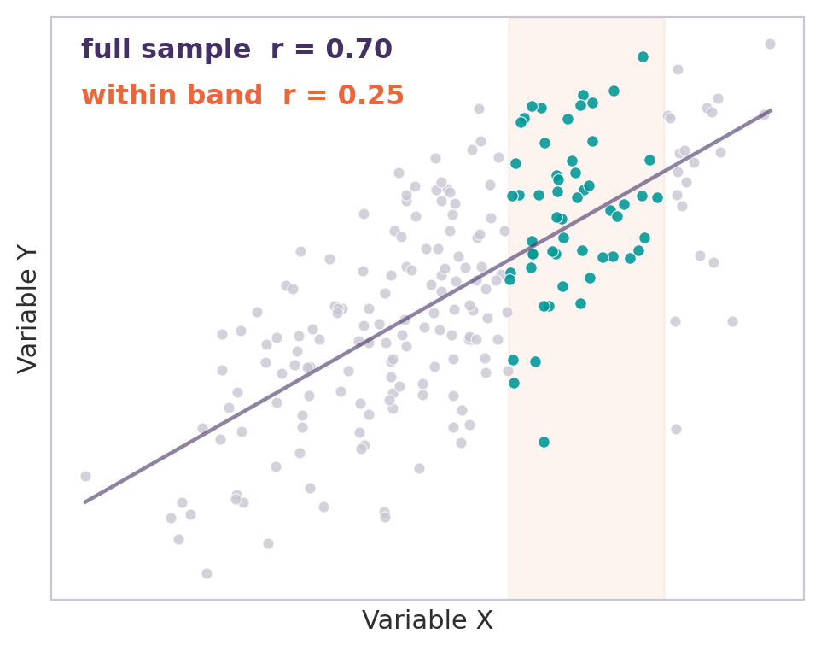
CHALLENGE · RESTRICTED RANGE
When variability disappears, so does r
A narrow spread on either variable attenuates r, even when the underlying relationship is strong (Sackett & Yang, 2000).
Common in practice: when inclusion criteria enrol a narrow band – for example only severe patients – the baseline range is restricted by design.
Floor and ceiling effects, and homogeneous samples, compress the usable range the same way.
WHY IT HAPPENS
r is the covariance of two variables standardized by their standard deviations. If a variable barely varies, there is little covariance to detect, so r shrinks toward zero whatever the true relationship.
WHAT TO DO
The same data: a strong full-sample correlation nearly vanishes inside a narrow band.
Inspect the spread and distributions before correlating. Do not compare r across samples with different ranges, and for change, make sure enough patients actually change.
The same shrinkage happens if Y's range is restricted instead of X’s.
Volume 1 · Correlations · 1.0

Slide 75
CHALLENGE · MEASUREMENT ERROR
Measurement error pulls correlations toward zero
Unreliable measures attenuate the observed correlation below the true relationship between the constructs. The noisier the measures, the more r is pulled toward zero.
WATCH OUT
The disattenuated value estimates the latent correlation, but it is sensitive to the reliability estimates and can over-correct, sometimes exceeding 1. Treat it as an upper bound, not a result to report on its own.
Correction for attenuation
r_{true} ≈ r_{obs} / √( r_{XX} · r_{YY} ) e.g. 0.50 / √(0.80 · 0.80) = 0.63
where rXX and rYY are the test-retest reliabilities. Use an ICC and state its form: a Pearson correlation between occasions ignores systematic shift and under-corrects.
Spearman (1904); Nunnally & Bernstein (1994).
WHAT TO DO
Report the observed correlation and the reliabilities used. If you disattenuate, show the corrected value alongside the observed one.
While this formula is useful, proper measure development ensures more reliable measures - which is preferable to estimating corrected value.
Volume 1 · Correlations · 1.0

Slide 76
INTERPRETING CHANGE · ANCHORS
Anchors: external references for interpreting change
Anchors recur throughout responsiveness and meaningful-change work, so they are worth defining. An anchor is a separate, interpretable measure used to give meaning to scores or change on the target measure.
WHAT IT IS
WHAT MAKES A GOOD ANCHOR
Typically a global rating – the Patient Global Impression of Change (PGIC) or Severity (PGIS) – or a clinical milestone that patients and clinicians readily understand.
Appreciably correlated with change on the target. The cited ≥|0.30| is a low floor, not a target: higher is preferred.
Itself interpretable and meaningful to patients or clinicians.
A defensible recall period for the concept being rated.
Measure the same concept as the measure of interest.
WHAT IT IS FOR
Anchors underpin responsiveness evidence and the estimation of meaningful change. The change correlation between target and anchor is the central piece of evidence.
WATCH OUT
A weak or biased anchor undermines every conclusion drawn from it – see recall bias next.
The anchor’s validity rests on qualitative and quantitative evidence, not psychometrics alone, even if it’s treated as the quantitative gold standard.
Volume 1 · Correlations · 1.0

Slide 77
CHALLENGE · RECALL BIAS
Recall bias in retrospective ratings
Anchors and some PROs ask patients to recall a past state or summarize a period. Recall is reconstructed, not replayed.
WHAT TO DO
Keep recall windows short and prefer momentary or prospective assessment where the design allows it. Choose anchors with a defensible recall period for the concept.
Retrospective ratings are colored by the patient’s current state and by recent or peak experiences (Stull et al., 2009).
Longer recall windows make the bias worse.
A biased anchor distorts the very change correlation it is meant to support.
Examples: PGI-C and CGI-C
Worth remembering: a global rating of change asks patients to compare now with a past they may no longer represent accurately. Further, recall period can change as time goes on. Interpret anchor-based change correlations with that limit in view.
Volume 1 · Correlations · 1.0

Slide 78
CHALLENGE · CHANGE VS CROSS-SECTIONAL
Change and cross-sectional correlations are not comparable
CROSS-SECTIONAL
CHANGE SCORE CORRELATION
Cannot demonstrate responsiveness; a strong r may reflect a shared concept, not sensitivity to change.
Response shift: patients’ internal standards or how they understand the concept can change over time, so cross-sectional validity need not imply responsiveness.
Driven by differences between patients, not change within them.
Usually lower, because error compounds across two measurements.
Limited improvement or worsening reduces the change variance to correlate.
Strongly dependent on the anchor, and on floor or ceiling effects and reliability of the change score.
WATCH OUT
Regression to the mean: extreme baseline scores drift toward the average, so change correlates negatively with baseline before any treatment effect. Baseline sits on both sides of the subtraction, so this is close to automatic (Clifton & Clifton, 2019).
A study that measures different samples of patients at multiple time points (repeated cross-sections) is not the same as a longitudinal study that tracks the same patients over time—even though both “have multiple time points. ”
WHAT TO DO
Do not expect change and cross-sectional correlations to match. Use cross-sectional for construct validity and change for responsiveness, pre-specify each, and be wary of baseline-change correlations.
Volume 1 · Correlations · 1.0

Slide 79
CHALLENGES · CHECKLIST
A checklist for a trustworthy correlation
Plan for precision
Size the study around the expected r, and report confidence intervals.
Handle missing data well
Report its rate and pattern; in the context of psychometric work prefer observed data with a pre-specified rule over imputing.
Check the spread
Watch for restricted range, floor, and ceiling before interpreting r.
Respect measurement error
It attenuates r; correct for reliability only with caution, and show both values.
Mind anchors and recall
Define the anchor, keep recall windows short, and pick a defensible period.
Keep the levels apart
Do not compare change with cross-sectional r, and beware regression to the mean.
Volume 1 · Correlations · 1.0

Slide 80
APPENDIX · REFERENCES
References
Slide 68 Schönbrodt, F. D., & Perugini, M. (2013). At what sample size do correlations stabilize? J Res Pers, 47(5), 609-612.
Slide 73 Little, R. J. A., & Rubin, D. B. (2019). Statistical Analysis with Missing Data (3rd ed.). Wiley.
Slide 70 Sackett, P. R., & Yang, H. (2000). Correction for range restriction: An expanded typology. J Appl Psychol, 85(1), 112-118.
Slide 71 Spearman, C. (1904). The proof and measurement of association between two things. Am J Psychol, 15, 72-101;
Nunnally, J. C., & Bernstein, I. H. (1994). Psychometric Theory (3rd ed.). McGraw-Hill (correction for attenuation).
Slide 76 Revicki, D., et al. (2008). Determining responsiveness and minimally important differences for PROs. J Clin Epidemiol, 61(2), 102-109;
Coon, C. D., & Cappelleri, J. C. (2016). Interpreting change in scores on PRO instruments. Ther Innov Regul Sci, 50(1), 22-29;
Devji, T., et al. (2020). Credibility of anchor-based estimates of minimal important differences. BMJ, 369, m1714.
Slide 73 Stull, D. E., Leidy, N. K., Parasuraman, B., & Chassany, O. (2009). Optimal recall periods for patient-reported outcomes: challenges and potential solutions. Curr Med Res Opin, 25(4), 929-942.
Slide 76 Barnett, A. G., van der Pols, J. C., & Dobson, A. J. (2005). Regression to the mean: what it is and how to deal with it. Int J Epidemiol, 34(1), 215-220;
Clifton, L., & Clifton, D. A. (2019). The correlation between baseline score and post-intervention score, and its implications for statistical analysis. Trials, 20, 43.
Sprangers, M. A. G., & Schwartz, C. E. (1999) Integrating response shift into health-related quality of life research. Soc Sci Med, 48(11), 1507-1515.
Volume 1 · Correlations · 1.0

Slide 81
TOPIC 6
Further Relevant Concepts
Concepts that are useful for alongside correlation and change how a coefficient should be interpreted.
Volume 1 · Correlations · 1.0

Slide 82
ANCHORS
What anchors are available and should they be used
DEFINITION: External measure, distinct from the PRO being evaluated, used to give meaning to a score or a change in score on that PRO
WATCH OUT
The anchor must itself be interpretable and understandable to patients or clinicians.
Select an anchor theoretically linked to the measured concept, pre-specified prior to analysis.
A weak or biased anchor invalidates any conclusion that depends on it.
WHEN TO USE
To estimate a minimal clinically important change from the patient's perspective (Minimal Within-Patient Change).
To provide evidence of the "responsiveness" (sensitivity to change) of a PRO/COA.
METHODS
Calculate the correlation between the change in the target instrument and the change (or level) of the anchor.
Verify that the change-anchor correlation is "appreciable": commonly threshold = 0.30.
List of main anchors:
State anchors: CGIS, PGIS,
Anchors of change: CGIC, PGIC
Volume 1 · Correlations · 1.0

Slide 83
LATENT VARIABLE
What are Latent variables
DEFINITION:
A variable that cannot be measured directly but is inferred from other observed variables.
EXAMPLE:
The total score on a quality-of-life questionnaire is an observed variable; the quality of life it is intended to measure is the latent variable.
A 10-item depression scale observes 10 manifest variables linked to a single latent variable: depression severity.
USED when a COA instrument is built on the assumption that a score reflects an underlying theoretical construct
WATCH OUT
How to construct and Verify:
EFA, a statistical method that explores, without strong a priori hypotheses, how many latent variables underlie a set of items and which items are associated with which factor.
CFA is a method that tests a pre-specified structure of latent variables and their hypothesized item loadings against observed data by evaluating model fit.
The latent variable is never measured directly, only estimated.
A latent variable is a modeling assumption, not an empirical fact
The latent variable remains a construct, not an object measurable in itself.
Volume 1 · Correlations · 1.0

Slide 84
INTERPRETATION BONUS
R²
Definition:
R² is the square of the Pearson correlation coefficient r. It represents the proportion of the variance of one variable explained by the other.
Uses:
To correctly compare two correlations of different magnitudes.
As an alternative effect size to communicate the importance of an association. Often more intuitive than r for a non-statistical audience.
In multiple regression, to assess the total variance explained by a set of predictors.
% of shared variance.
WATCH OUT
R² loses the sign of the association. Always present r alongside R².
R² is not linearly comparable to r.
Do not interpret R² as causality
EXAMPLE:
Result of correlation between PRO and an anchor is r = 0.7 . R² = 0.49, so 49% shared variance between the PRO and the anchor.
A first result of correlation obtained is r = 0.5; a second one is r = 0.25. The R² are 0.25 and 0.0625. The first association is 4 times stronger in terms of explained variance, not twice as strong.
Volume 1 · Correlations · 1.0

Slide 85
INTERPRETATION BONUS
Scoring direction
WATCH OUT
Scoring direction of the variable:
describes how a score is coded in terms of clinical meaning: does a higher score indicate a better or worse health status?
This choice of convention (e.g., 0 = no symptoms vs. 0 = best health) directly affects the sign of the observed correlations.
Context of importance:
Whenever the sign of a correlation between two COAs, or between a COA and an anchor is interpreted.
Before comparing correlations across multiple instruments (scoring directions must be harmonized; otherwise, the signs become inconsistent and misleading).
Solutions:
Explicitly document the scoring direction for each instrument.
Before calculating or interpreting a correlation between two measures, verify that their scoring directions are known and consistent (if necessary, reverse one of the scores, e.g., by multiplying by −1 or using reverse-coding).
In a validation report, always state the expected direction of the correlation based on the clinical meaning of each scale, rather than just the raw statistical sign.
Note if a score has been reversed
Always specify the scoring direction in the legend of any correlation table or matrix.
Some instruments change conventions between versions check the scoring direction before comparing studies over time.
Volume 1 · Correlations · 1.0

Slide 86
STATISTICAL PARADOXES
Simpson’s Paradox and Lord’s Paradox
DEFINITION:
A pattern seen within every subgroup can reverse, weaken, or disappear once the subgroups are combined (Simpson, 1951). In repeated-measures or change-score analyses, adjusting for baseline can flip the direction of an effect (Lord, 1967) — this specific case is often called Lord’s Paradox.
EXAMPLE:
A treatment appears to reduce symptom severity in the pooled sample, but within each disease-severity subgroup it shows no effect. The pooled correlation is driven by which subgroup patients fall into, not by the treatment itself.
Two clinicians' baseline severity ratings correlate positively across patients, but after adjusting for each patient's own baseline, the correlation between their change scores reverses sign.
WHEN
when a variable (e.g. disease severity, treatment group, baseline score) differs across subgroups and is correlated with both the variables being compared.
WATCH OUT
How to check:
Compute the correlation within each relevant subgroup, not only in the pooled sample.
If subgroup and pooled results disagree, report both and investigate the subgrouping or baseline variable before interpreting the pooled figure.
For change scores, check whether the correlation with baseline changes sign once the analysis is restricted to a homogeneous subgroup (Simpson, 1951; Lord, 1967).
A pooled correlation or mean difference can disagree with the result seen in every subgroup taken separately.
Checking only the aggregate can hide, or manufacture, a real reversal.
Adjusting for baseline can change the sign of a treatment or change effect, depending on how the compared groups differ at baseline (Lord’s Paradox).
Volume 1 · Correlations · 1.0

Slide 87
MEASUREMENT ERROR
Regression to the mean
DEFINITION:
Patients selected for having an extreme score (very high or very low) tend to score closer to the average on a later measurement, even with no real change and no intervention (Barnett, van der Pols, & Dobson, 2005).
EXAMPLE:
A trial enrolls only patients with the most severe baseline symptom scores. At follow-up, average scores improve, but part of that improvement would have happened without treatment, simply because extreme baseline scorers regress toward the mean.
WHEN
when patients are selected or enrolled based on an extreme baseline score, and again whenever a baseline-to-change correlation is interpreted.
WATCH OUT
How to guard against it:
Use a control or comparison group selected the same way, so both groups regress equally.
Do not rely on a single extreme baseline measurement.
Be cautious interpreting any correlation between a baseline score and its own change score.
Regression to the mean can manufacture a negative baseline-to-change correlation even with no true change: extreme scorers drift toward the average.
It is not measurement error alone, it also comes from imperfect reliability and from within-person fluctuation over time.
It can be mistaken for a genuine treatment effect if patients are selected on an extreme baseline score and there is no control group.
Volume 1 · Correlations · 1.0

Slide 88
ITEM ANALYSIS
Corrected item-total correlation
DEFINITION:
The correlation between one item’s score and the sum of the other items in the scale, excluding that item itself. “Corrected” refers to that exclusion, without it, the item would be partly correlated with itself.
EXAMPLE:
A 10-item scale: item 7’s corrected item-total correlation is r = 0.15, well below the other items (r = 0.40–0.60).
This flags item 7 for review, it may be poorly worded, measure a different construct, or need rescoring. This result is not an automatic instruction to delete it.
USED
during scale development or refinement, to check whether each item contributes to the same construct as the rest of the scale.
WATCH OUT
How it differs from the uncorrected version:
Uncorrected item-total correlation includes the item itself in the total, which inflates the estimate, especially in short scales, where one item is a larger share of the total.
The corrected version is the one commonly reported and the one typically meant by “item-total correlation”.
Related to, but distinct from, inter-item correlations: item-total looks at one item against the rest combined, inter-item looks at item pairs.
A low value can mean a bad item, but can also mean the scale is multidimensional and this item belongs to a different factor
A high value can hide item redundancy: two near-identical items will both show strong corrected item-total correlations without adding information.
The value is sample-dependent and does not account for item difficulty or location, so it should not be the only criterion for retaining or removing an item.
Volume 1 · Correlations · 1.0

Slide 89
MEASUREMENT ERROR
Reliability and attenuation
DEFINITION:
The reliability of a measure is the square of the correlation between its observed score and the true score.
Every observed score is split into two parts: x = τ + ε, where x is the observed score, τ (tau) is the true, latent score, and ε (epsilon) is measurement error.
Reliability is defined from this model as r(x,x′) = r(x,τ)²
The correction-for-attenuation formula estimates the true-score correlation: r(τx,τy) = r(x,y) / √(r(x,x′) × r(y,y′)) (Spearman, 1904).
EXAMPLE:
Two PROMs correlate at r = 0.50. If each has a reliability of r(x,x′) = 0.70, the attenuation-corrected estimate of the true-score correlation is 0.50 / √(0.70 × 0.70) ≈ 0.71.
WHY IT MATTERS
Every correlation computed on observed scores (x, y) is a correlation between two noisy proxies for the constructs you actually care about (τx, τy). Error in either measure pulls the observed correlation toward zero relative to the true relationship.
WATCH OUT
A correlation that looks weak may reflect low reliability, not a weak true relationship — check reliability before concluding the constructs are unrelated.
Lord & Novick (1968, Ch. 3) show this only holds if r(x,y) ≤ √r(x,x′); a corrected value above 1.0 signals a violation of the model, not a stronger relationship.
When the observed correlation is pushed toward 1 by learning (PerfO), this is the opposite problem from attenuation, and the correction-for-attenuation formula does not apply, since the extra correlation isn't due to reliability at all.
Volume 1 · Correlations · 1.0

Slide 90
APPENDIX · REFERENCES
References
Slide 83 Borsboom, D., Mellenbergh, G. J., & van Heerden, J. (2003). The theoretical status of latent variables. Psychological Review, 110(2), 203-219.
Slide 84 Ozer, D. J. (1985). Correlation and the coefficient of determination. Psychological Bulletin, 97(2), 307-315.
Slide 85 Streiner, D. L., Norman, G. R., & Cairney, J. (2024). Health Measurement Scales: A practical guide to their development and use (6th ed.). Oxford University Press.
Slide 86 Simpson, E. H. (1951). The interpretation of interaction in contingency tables. Journal of the Royal Statistical Society B, 13(2), 238-241; Lord, F. M. (1967). A paradox in the interpretation of group comparisons. Psychological Bulletin, 68(5), 304-305.
Slide 87 Barnett, A. G., van der Pols, J. C., & Dobson, A. J. (2005). Regression to the mean: what it is and how to deal with it. International Journal of Epidemiology, 34(1), 215-220.
Slide 88 Nunnally, J. C., & Bernstein, I. H. (1994). Psychometric Theory (3rd ed.). McGraw-Hill.
Slide 89 Lord, F. M., & Novick, M. R. (1968). Statistical Theories of Mental Test Scores. Addison-Wesley, Menlo Park.
Volume 1 · Correlations · 1.0

